Slide 1
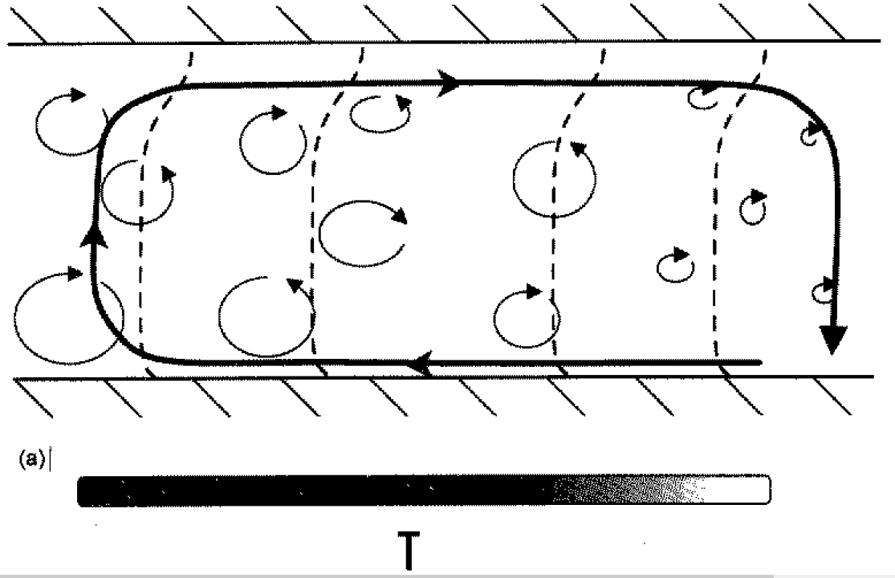
T₊
T₋
boundary temperature gradient
From Emanuel et al., 1994
Notes:
(a) Small-scale convection and large-scale circulation in a parallel-plate apparatus with an imposed horizontal temperature gradient at the boundaries. It is understood that the width of this domain is very much greater than its depth. The dashed lines show contours of temperature, with higher values at the left. In this case the large-scale circulation is not strong enough to suppress convection over the colder side of the apparatus. (b) As (a) but for a case in whcih the imposed horizontal temperature gradient is strong enough to drive a large-scale circulation that suppresses convection over the colder side of the domain. An inversio-capped boundary layer forms over the colder part of the apparatus in this case. (From Emanuel et al., 1994).

Slide 2
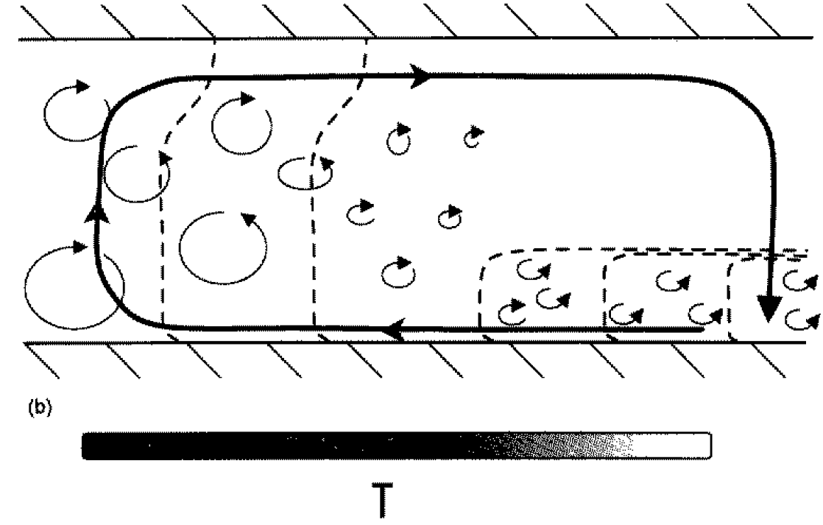

Slide 3
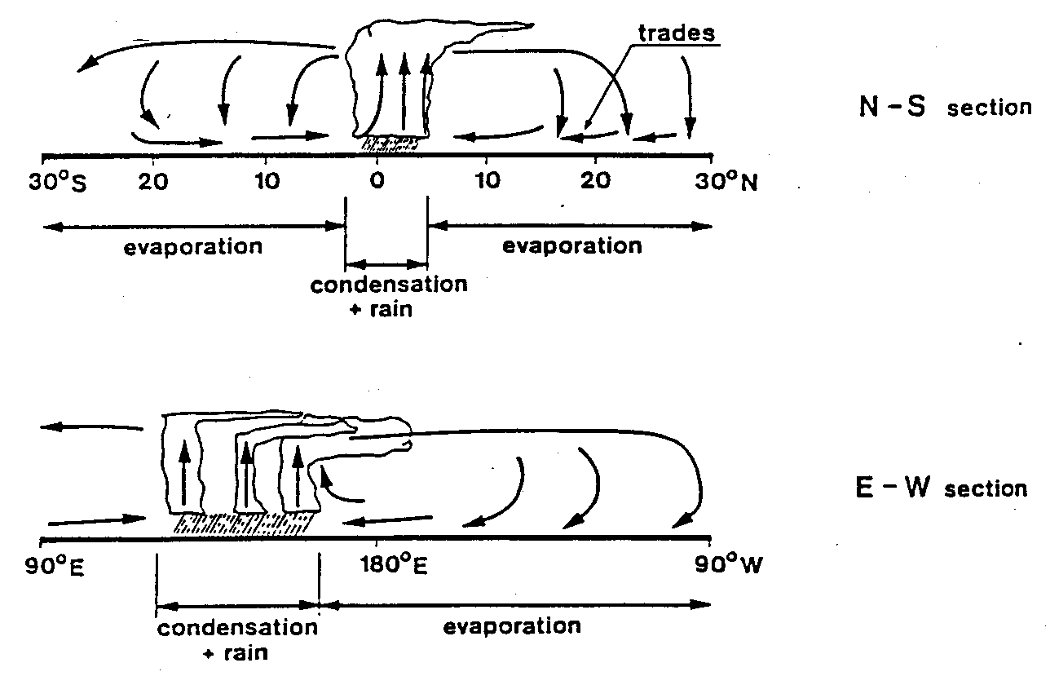
The moisture cycle in the tropics

Slide 4
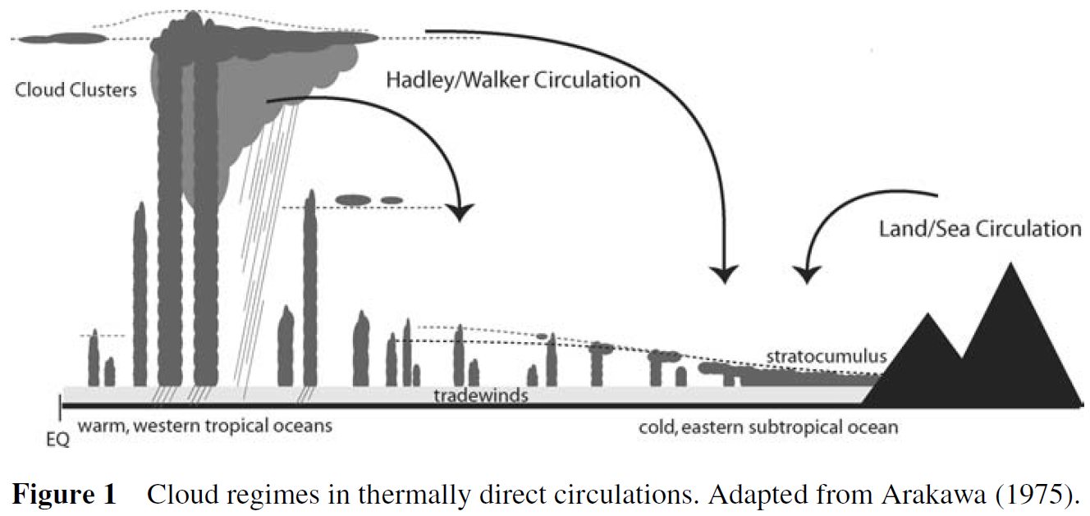

Slide 5
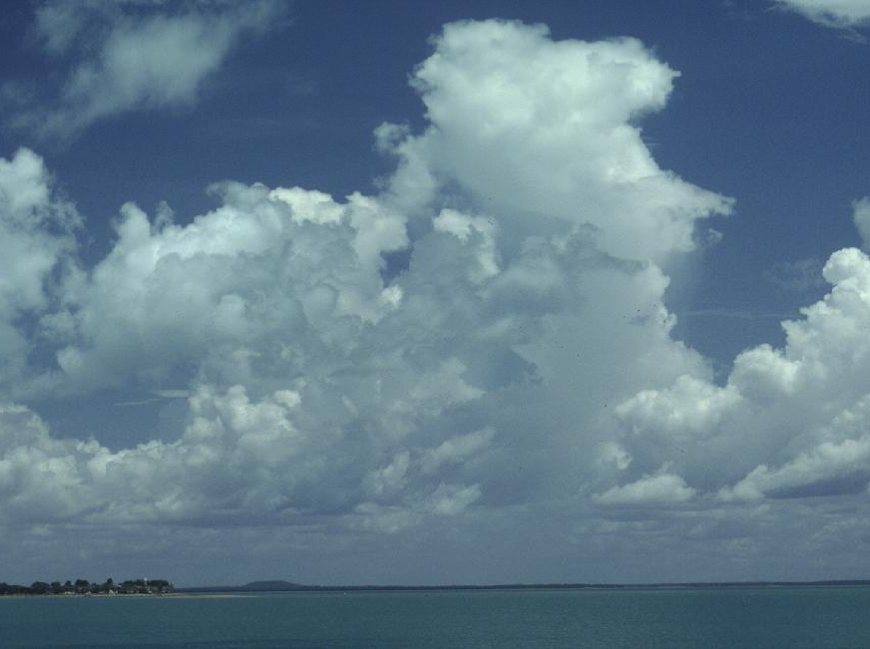

Slide 6
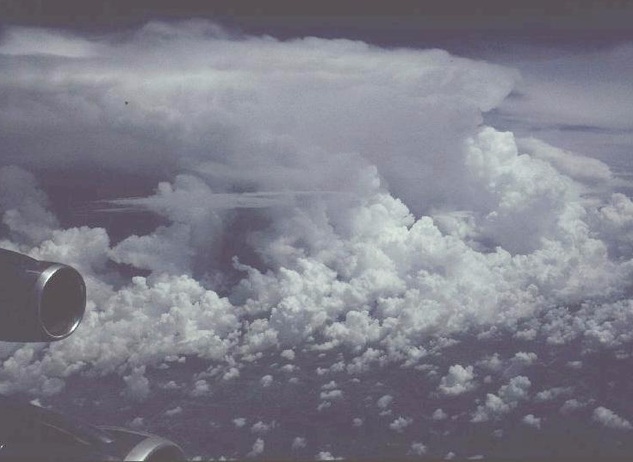

Slide 7
Trade Cumuli

