Slide 1
The impact of localization and observation averaging for convective-scale data assimilation in a simple stochastic model
Michael Würsch, George C. Craig
Meteorological Institute
University of Munich
Joint SRNWP Workshop on Data Assimilation and Ensemble Prediction Systems
23-25 February 2011, Bologna, Italy

Slide 2
Motivation
Introduce a minimal model
Key features: spatial intermittency, stochastic evolution
Examine the performance of ETKF and particle filter
Look at two different strategies to improve methods
Localization and observation averaging
Notes:
The new generation of kilometre-scale NWP models creates new challenges for data assimilation as the models may benefit from the assimilation of sources of information like radar.
The purpose of our work is to introduce a minimal model that represents the key features of spatial intermittency and stochastic evolution of a convecting atmosphere. This will provide a simple testbed to examine the performance of various data assimilation methods.
two strategies to make these methods more effective on these problems. Localization and observation averaging.
(Conventional data assimilation methods can have difficulties in this context because of both the nonlinearity that is associated with the rapid evolution of convective clouds, and the non-Gaussianity of error statistics in a highly intermittent cloud field. )

Slide 3
Problems of radar data assimilation
Lack of spatial correlations prevents reduction in degrees of freedom
Curse of dimensionality (Bellman 1957, 1961)
Lack of temporal correlation between observation times
Stochastic evolution of the model field
No balance constraints
No geostrophic or comparable balance constraints applicable
Notes:
So we thought that there are a couple of key problems which standard data assimilation methods have and wanted to chose our methods and the model such that one would see the consequences and possible solutions to them.
The main implication of the intermittency of precipitation fields is the lack of spatial correlations to reduce the degrees of freedom. The reason why this is bad is the so-called curse of dimensionality of Bellman which declares that the number of possible states of a system increases exponentially as the dimensionality of the system grows.
The second is that the nonlinearity associated with convective clouds produces a lack of temporal correlation between observation times, resulting in a stochastic component to the evolution of the field. With that I mean that an unobserved feature at one time can appear as a precipitating cloud one step later. The challenge of a data assimilation system here is to maintain diversity in an ensemble and ensure the representation of such errors in the distribution.
In 4DVAR it is assumed that the background error can be described by a matrix whose size can be reduced to a manageable number of degrees of freedom by balance assumptions and observations of correlations. But this is not possible in radar assimilation.
(1min15)

Slide 4
Data Assimilation Methods
Ensemble Transform Kalman Filter (ETKF)
ETKF (Bishop et al. 2001; Hunt et al. 2007)
Sequential Importance Resampling (SIR)
SIR (Gordon et al. 1993, Van Leeuwen 2009)
Notes:
Now to start with the methods, we decided to use an ensemble kalman filter and the particle filter of van Leeuwen.
These two methods were chosen because they have a very different theoretical basis. The particle filter should be easy to anticipate since it is expected to respond directly to the dimensionality of the system, while the ETKF is being applied well outside of its regime of validity and may not work at all.

Slide 5
Possible Solutions
Localization
Analysis at a grid point is only influenced by observations close-by
LETKF of Hunt et al. (2007)
Local SIR filter (LSIR)
Observation Averaging
Averaged observations over a region to reduce intermittency
Sometimes called „super-obbing“
AETKF and ASIR
Notes:
We thought that there were two potential ways of coping with these errors. The first is localization, where the analysis at a given location is only influenced by observations that are close by in space and time. This is supposed to work as the atmosphere often has a local low dimensionality and therefore localization reduces a high dimensional problem to a set of problems of lower dimension. (Patil et al.)
The second strategy is observation averaging. By averaging the observations over a region in space, the intermittency is reduced. In the literature a new observation like that is sometimes called super-observation. Upscaling the observations does not only reduce the effective dimensionality of the system by introducing spatial correlations, it also produces more smoothly varying fields leading to better error statistics. The cost of this improvement is the loss of resolution.
(1:15)

Slide 6
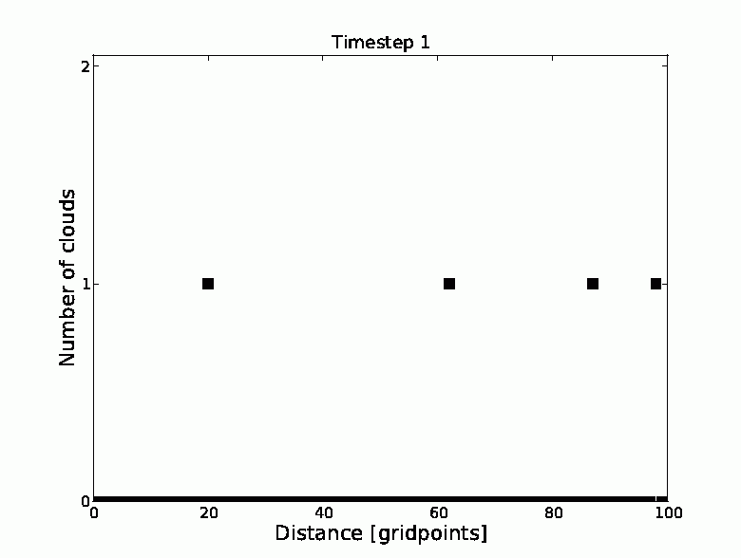
Toy Model
One spatial and one temporal dimension
Cloud distribution determined by birth/death probabilities
Leads to a mean cloud half life and an average density of clouds
Model & observations are perfect
Example run:
100 gridpoints
half life 30 time steps
average density of 0.1 clouds
black squares ■ mark the number and position of clouds
Notes:
The model has only a spatial and a temporal dimension and produces a changing number of clouds at every grid point. So at each grid point an integer number of clouds can be present.
The dynamical evolution is specified as a birth-death process with a given probability per time step, of a cloud being initiated and a probability, of each existing cloud disappearing.
These birth and death probabilities are related to a mean cloud half life and an average density of clouds per grid point.
One realization of this model is integrated as a truth simulation, and an ensemble of simulations is used for data assimilation.
The model and the observations are perfect to magnify the impact of the different methods and the observations are taken at every time step.

Slide 7
Toy Model
One spatial and one temporal dimension
Cloud distribution determined by birth/death probabilities
Leads to a mean cloud half life and an average density of clouds
Model & observations are perfect
Example run:
100 gridpoints
half life 30 time steps
average density of 0.1 clouds
black squares ■ mark the number and position of clouds
Notes:
Let‘s have a first look at a simple example of the bahaviour of the model. Random initialization, stochastic evolution of clouds.
By random chance this is a situation with only 4 clouds initially.

Slide 8
Model setting
Basic settings:
100 grid points
Half-life (hl) is 30 (varying problem) or 3000 (stationary problem) time steps
Average cloud density is 0.1 per grid point
hl30 corresponds to 2.5 hours
Special settings:
Averaging is applied for regions of 10 grid points
Localization is applied to every grid point with a localization radius of 0
Notes:
For all the results you will see later, the number of grid points is fixed to 100. The average cloud lifetime is set to 30 or in some experiments 3000 time steps. The mean cloud density is 0.1, so on average there is only 1 cloud per 10 grid points which provides a realistic degree of intermittency.
To make a connection to the real world, if radar observations were available every 5 minutes, a mean cloud lifetime of 30 time steps would correspond to 2.5 hours. So in principle it would be possible for the assimilation to lock on to an observed cloud before it randomly disappears.
For observation averaging, the observations are taken as the total number of clouds in regions of 10 grid points and localization is applied on every grid point without taking into account information from neighbouring points.
(radar provides a spatially complete view of precipitation, but relatively little information about the dynamic variables associated with its evolution).

Slide 9
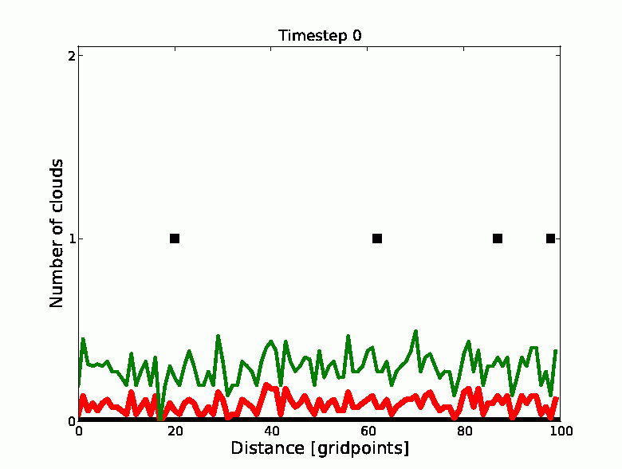
Example Runs
Ensemble size: 50
Half life: 3000
Method: ETKF
Red line: ensemble mean
Green line: ensemble spread
Notes:
Here is an example of an assimilation with the ETKF, a half life of 3000 and a 50 member ensemble for 100 timesteps. The rest of the parameters is set as you have just seen.
Describe plot.

Slide 10
Example Runs
Ensemble size: 50
Half life: 3000
Method: ETKF
Red line: ensemble mean
Green line: ensemble spread
Clouds are assimilated fast
Noise stays long
Some „wrong“ clouds
Notes:
It takes 15-20 steps until the clouds are assimilated. But then the noise is reduced very slowly and you can imagine that with a half life of only 30 time steps this noise cannot be removed. The ETKF also sometimes has a cloud at a position where there should not be one.

Slide 11
Example Runs
Ensemble size: 50
Half life: 3000
Method: SIR
Red line: ensemble mean
Green line: ensemble spread
Notes:
Now we have a look at the same thing for the particle filter.

Slide 12
Example Runs
Ensemble size: 50
Half life: 3000
Method: SIR
Red line: ensemble mean
Green line: ensemble spread
Clouds are assimilated slowly
Noise is gone very fast
Many „wrong“ clouds
Notes:
The initial noise is gone very fast. But there are clouds assimilated at wrong positions in most of the ensemble members. Then the rest of the time is used to get the correct clouds and get rid of the wrong ones. (which in a particle filter is a random process) Again here you can imagine that for this ensemble size both filters wont‘t be able to track changes in a time-varying observation field
(To achieve that, in a particle filter two things need to happen one after another. First, the random noise has to be large enough to trigger a cloud at the correct grid point. Second, the resampling mechanism has to copy the new, better ensemble member in order to assimilate the cloud in all members.)
Of course the performance of the filters might be improved by tuning but in all our experiments we kept the configurations the same to be able to compare the different results. Sensitivity experiments have shown that the points we want to make do not change if we tune some parameters.

Slide 13
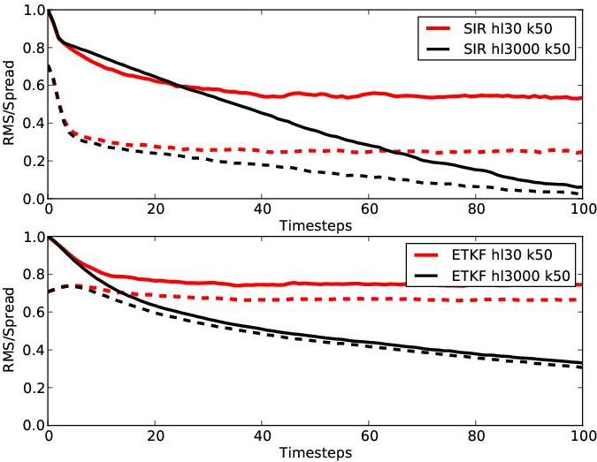
Results – Example Runs
______ Continuous line: RMSE
_ _ _ _ Dashed line: Ensemble spread
SIR:
Hl3000: Almost perfect after 100 time steps
Hl30: After 40 time steps more or less constant error
ETKF:
Hl3000: slowly converges to a small error
Hl30: Does not get better than 0.8
Spread and error are similar
Notes:
Root mean squared error (solid line) and ensemble spread (dashed) for an ensemble size of 50 with increasing time for (a) SIR and (b) ETKF with half-lives of 3000 (thin) and 30 (thick) time steps.
To get these results I did 100 random runs and averaged the errors to get better statistics. All the upcoming results will be for 100 runs and the error is scaled such that a random distribution has an average error of one. (average error between two randomly chosen states)
SIR Steady decrease of error shows the effectiveness of resampling.
As you can see with a half-life of 30, after 100 time steps the error is quite constant. Because of that a final error is defined as the error after these 100 time steps for the half life 30 case, and after 500 steps for the half life 3000 case.

Slide 14
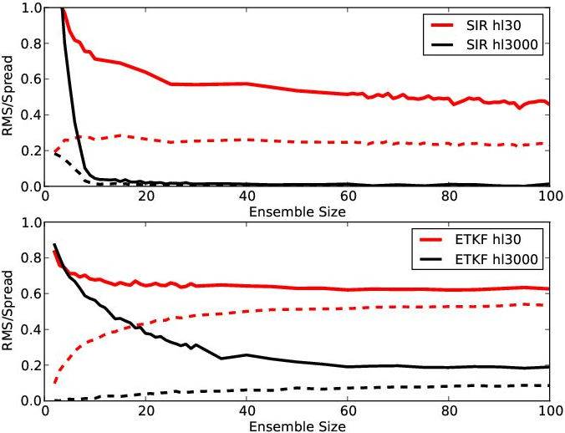
Changing Ensemble size
SIR:
Hl3000: SIR is almost perfect
Hl30: Decreases slowly with increasing ensemble size. Still at 0.4 with 200 members
ETKF:
Hl3000: Error only decreases significantly up to 40 members
Hl30: Almost no improvement
For larger ensembles error and spread are almost constant
______ Continuous line: RMSE
_ _ _ _ Dashed line: Ensemble spread
Notes:
Now we have a look at how this final error changes with ensemble size.
Describe plot
SIR for stationary case is perfect for ensemble sizes greater than 10. But for for a half life of 30 it only decreases rapidly up to 20 members, and afterwards the decrease is slow (because of the high dimensionality of the problem in catching the clouds fast enough, is not solved with a few members more) and is still at 0.4 for a 200 member ensemble.
The ETKF with stationary clouds improves significantly with ensemble size up to about 40 members. For the time-varying problem there is almost no improvement with ensemble size.
The spread always is in better agreement to the error for bigger ensembles. As this is always the case, and there is nothing remarkable about the spread, it won‘t show up in the next plots.

Slide 15
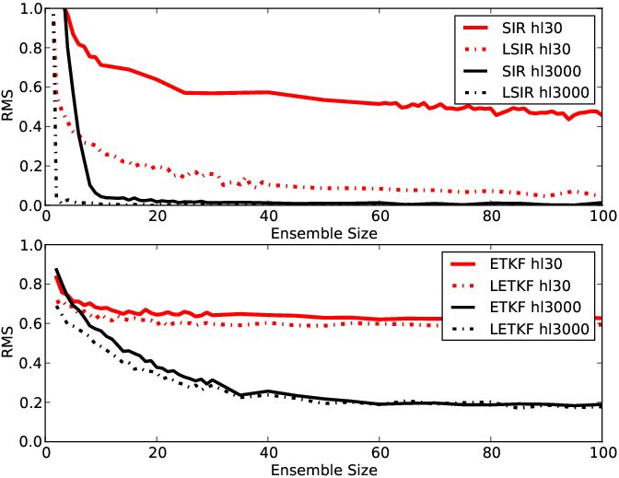
Localization
SIR:
Hl3000: Already perfect with 3 ensemble members
Hl30: Big upgrade compared to standard version
ETKF:
Hl3000+Hl30: Almost no difference to standard version
Notes:
Describe plot.
Of course for the particle filter it is clear that localization has such a big impact, as the the best-member selection now operates at every grid point seperately which makes it a lot easier for the algorithm to distinguish between a good and a bad member. And there is only the possibility of more or less 2 states. 0 and 1. So localization reduces the degrees of freedom dramatically. The normal situation has 2^100 = 10^30 possible states, while for the localized situation there 2 states at 100 gridpoints.
For the ETKF are the effects of localization very modest. We believe that this shows that localization does not change the fundamental non-Gaussian character of the system.

Slide 16
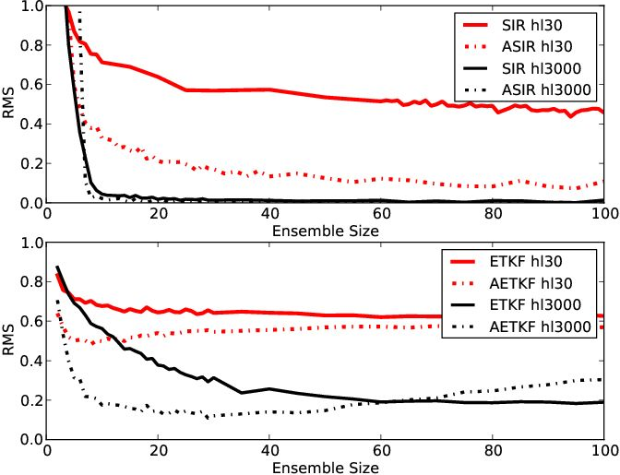
Averaging
SIR:
Hl3000: No improvement
Hl30: Not better than localization
ETKF:
Hl3000: Reduction in ensemble size to get error around 0.2
Notes:
Describe Plot
Here you have to take into account, that the error is calculated for the averaged regions. This means that if the error is 0, only the number of clouds in a subregion is assimilated perfect, but not the real position. So the errors are not directly comparable.
Sir with hl3000 we dont see a big difference, and for hl30 we see one, but as this is a lower resolution, it is not better than localization.
ETKF with hl3000 there is a significant reduction in the size of the ensemble which is needed to get an error around 0.2. You can see this here...
This might be useful, as in the full resolution, the filter might not give any reasonable results with ensemble sizes around 10, but the averaged version already gives useful results.
Tuning: The increase in error you can see here could be reversed with tuning of the covariance inflation. Comes from the fact that our error measurement punishes larger differences in clouds. And as with averaging we take the total number of clouds, the errors can be very large. This also increases the spread which then leads to worse results especially for larger ensemble sizes, where the spread is already larger anyway. So to improve these results, covariance deflation would help. Or of course another error measurement. But again as our results do not really change if we do that, we didnt do it.

Slide 17
Conclusions
Introduced a stochastic model that captures the key features of convective-scale data assimilation
SIR can give good results, but ensemble size is related to the dimensionality of the problem (can be very large)
Both standard methods fail when posed with the dynamical situation
Localization works very well for the SIR and has a smaller effect for the ETKF
Averaging seems more useful for the ETKF, especially for small ensembles
Outlook
Use a more complex model (shallow-water) to test interaction with gravity waves
Do idealised problems with the systems of COSMO/KENDA (Km-Scale Ensemble-Based Data Assimilation)
Notes:
From our experiments with different DA methods we draw the following conclusions.
Outlook:
The shallow water model also has the balance problem included.

Slide 19
Extra slide - Tuning
What happens when tuning SIR:
One can change how large the random perturbation is. If I make it larger, there is more noise and more correct clouds and RMS stays almost the same. The question is what one wants. Few correct clouds and little spread, or the opposite.
What happens when tuning ETKF:
Same as for SIR. More spread also increases the error. At least for bigger ensemble sizes, where ensemble and spread are already quite similar. It does not have to be absolutely identical. But with inflation, clouds are faster at the correct position.
Deflation makes the error go down faster initially (less spread), but final error is the same again.
Averaging ETKF:
Because the RMS punishes errors of 2 or 3 clouds too much, the spread is too large and covariance deflation is needed. Up to 0.7.
It would vary too fast if not.

Slide 20
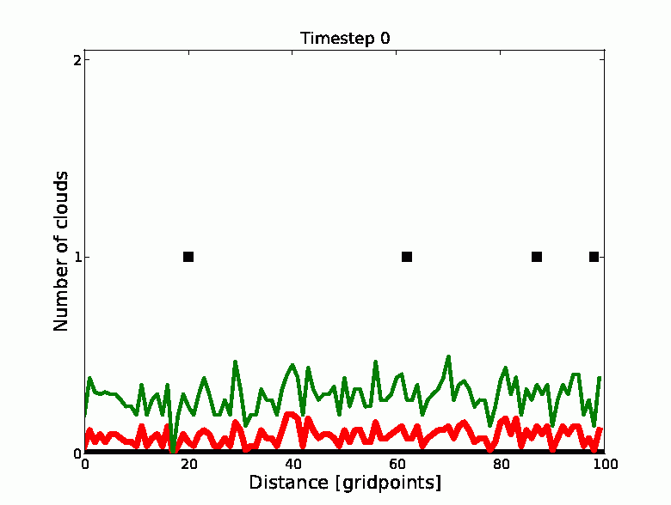
ETKF hl30, 50 ensembles

Slide 21
SIR hl30, 50 members

Slide 22
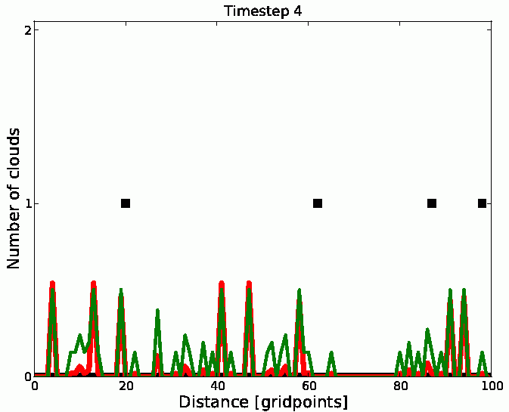
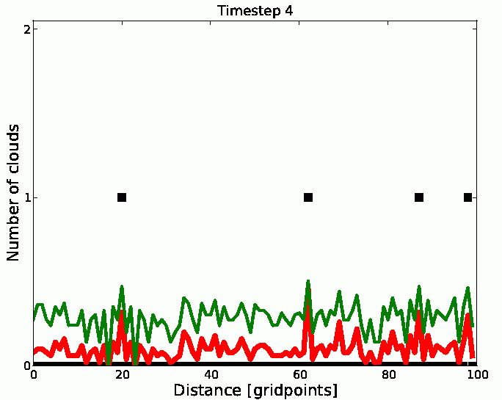
Comparison after 4 steps

Slide 23
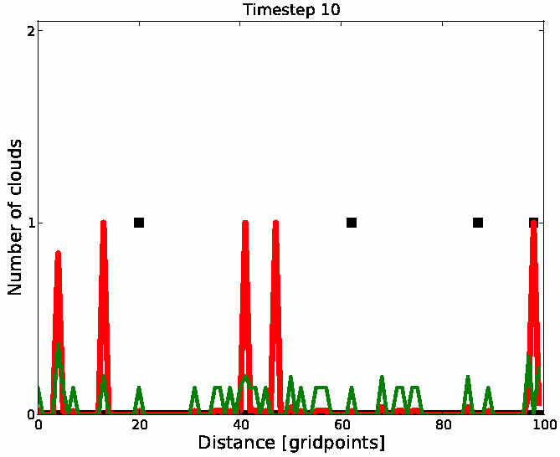
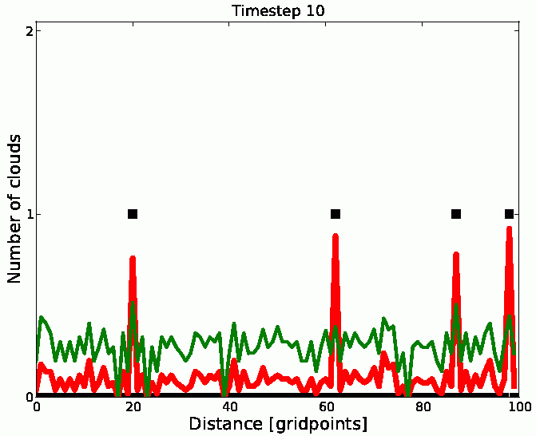
Comparison after 10 steps
SIR
ETKF

Slide 24
W-Matrix Hinton Diagrams

Slide 25
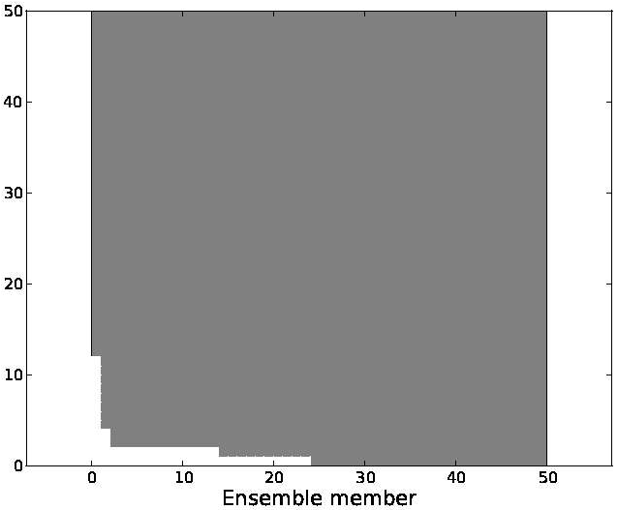
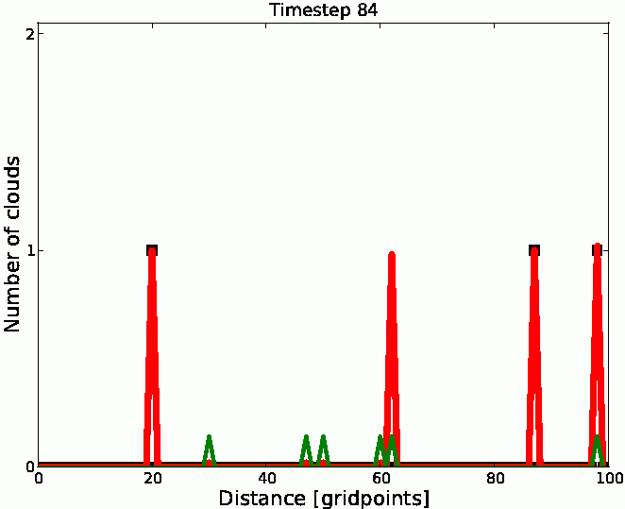
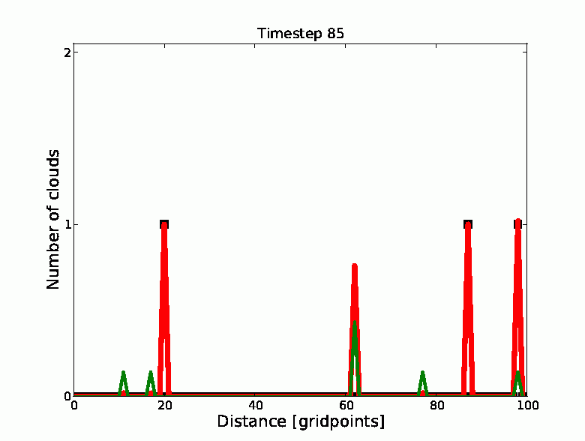
Example 1 SIR, hl 3000,k 50 Step 84-85
Notes:
One member is resampled 11 or 12 times. This process starts to remove the wrong cloud.

Slide 26
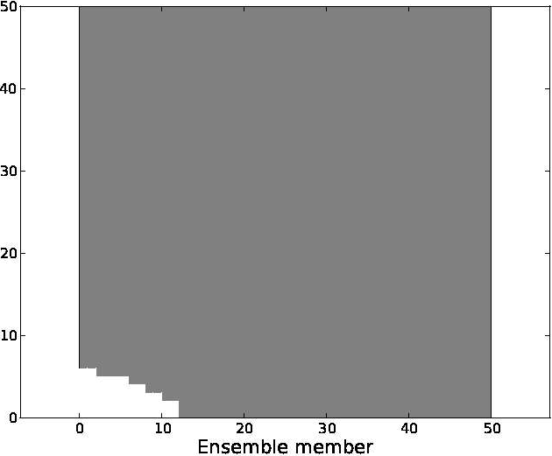
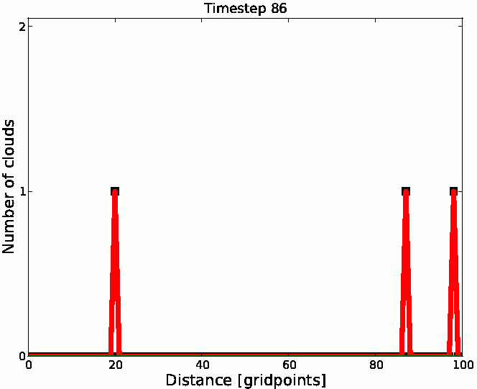
Example 1 SIR, hl 3000,k 50 Step 85-86
Notes:
Now one step later it is exactly these 11 or 12 members, that are resampled, as they are significantly better than the other ones. And finally the cloud is gone, and the ensemble is perfect.

Slide 27
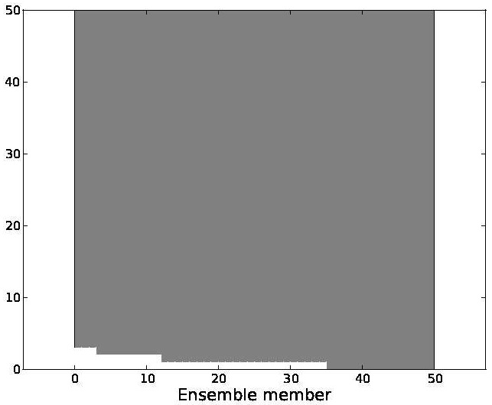
Example 1 SIR, hl 3000,k 50 Step 99 to 100

Slide 28
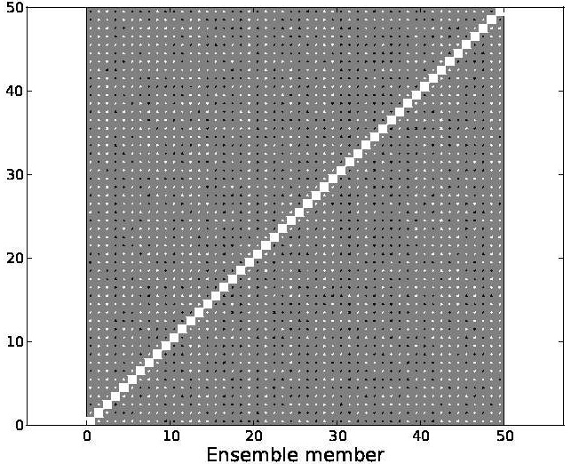
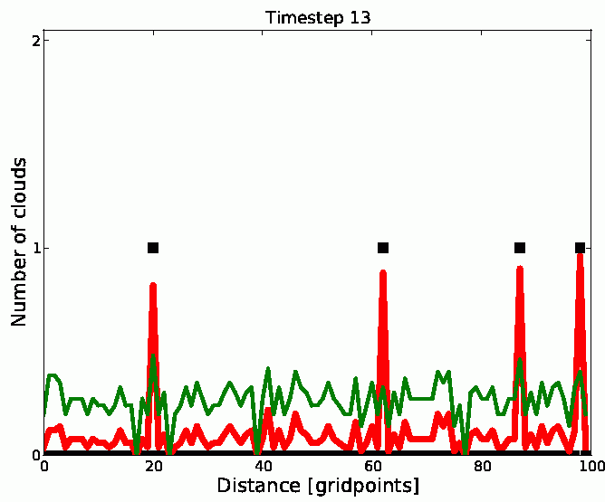
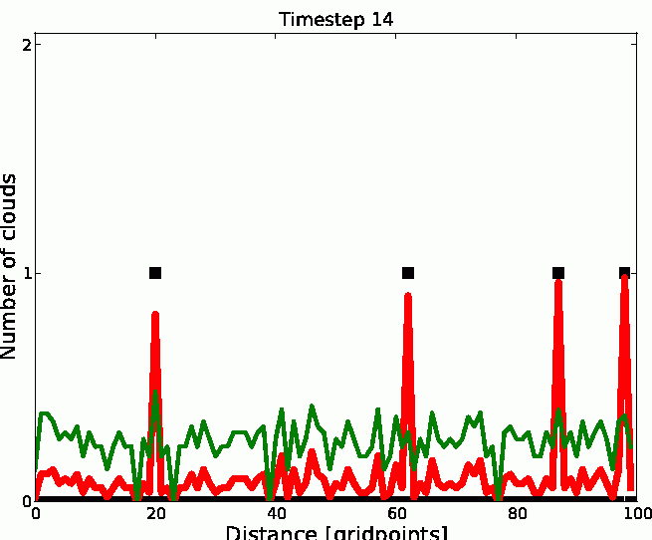
Example 1 ETKF, hl 3000,k 50 Step 13 to 14

Slide 29
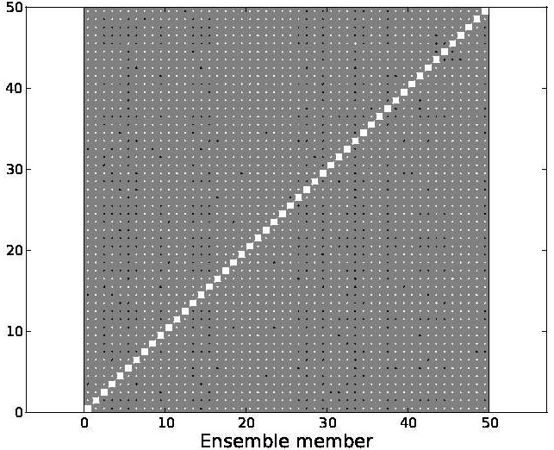
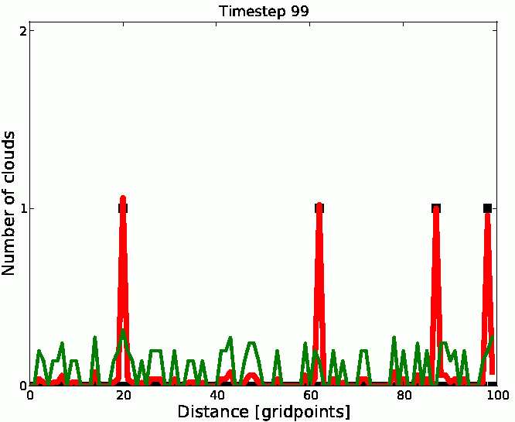
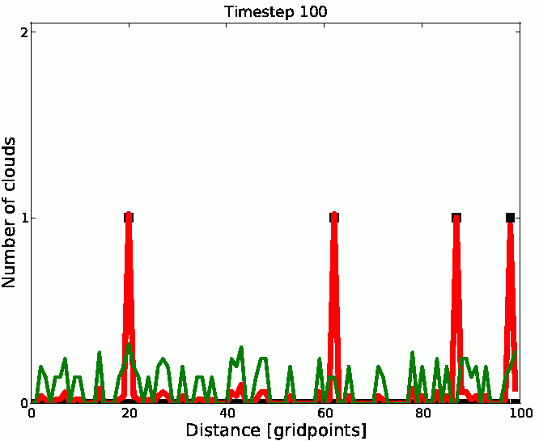
Example 1 ETKF, hl 3000,k 50 Step 99 to 100

