Slide 1
Processing and Formats
Main task for Metek is processing of the sampled data (2 TByte/h) so that no information is lost and so that it is easy to read for the the users.
New Parameters: Co-Cross-Correlation and Differential Phase
Format for saving the Spectra
IDL-GDL-python

Slide 2
Calculation of Co-Cross Correlation and Differential Phase
Co-Spectrum
Cross-Spectrum
Note, the average of a complex spectrum will vanish
If the phases co- and cross-polarized signals are related then the diagonal therm does not vanish

Slide 3
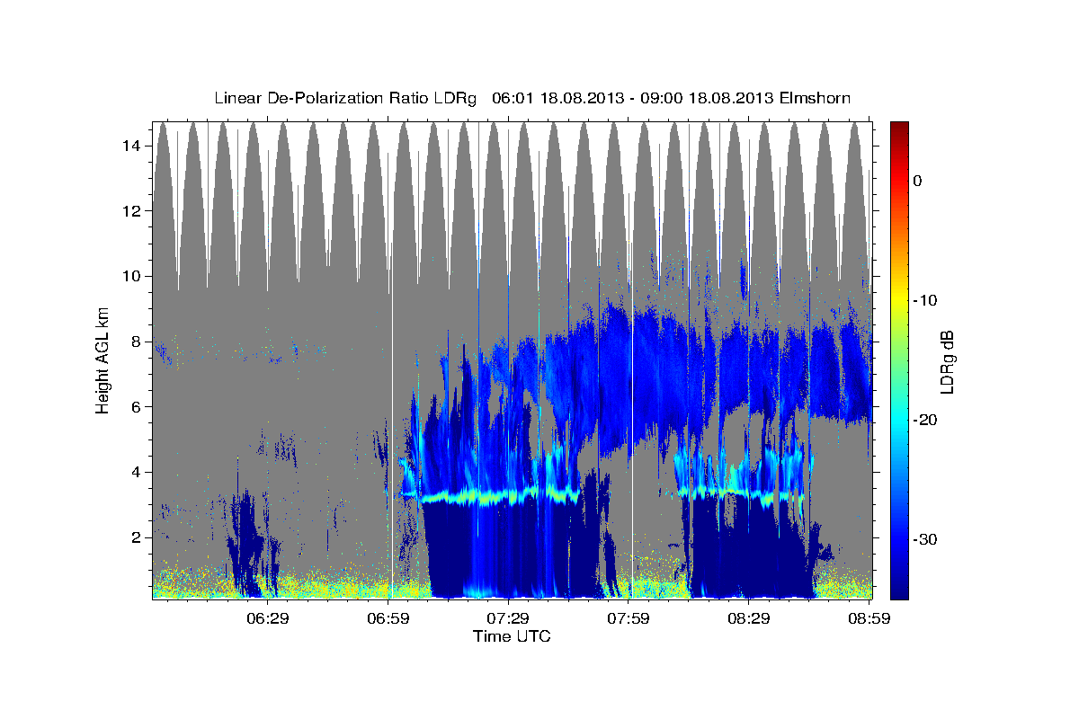

Slide 4
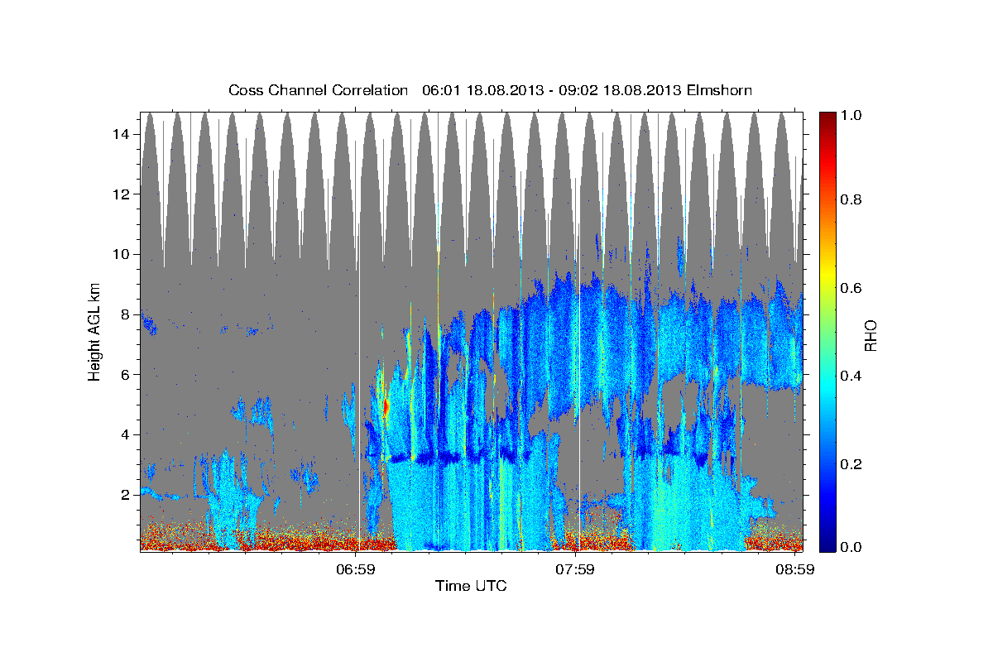

Slide 5
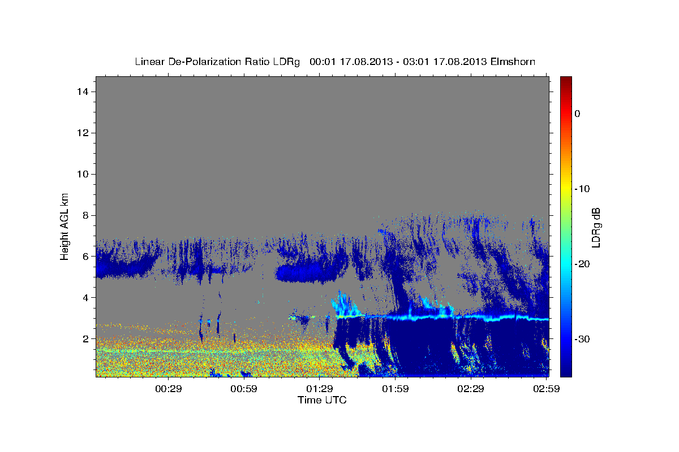

Slide 6
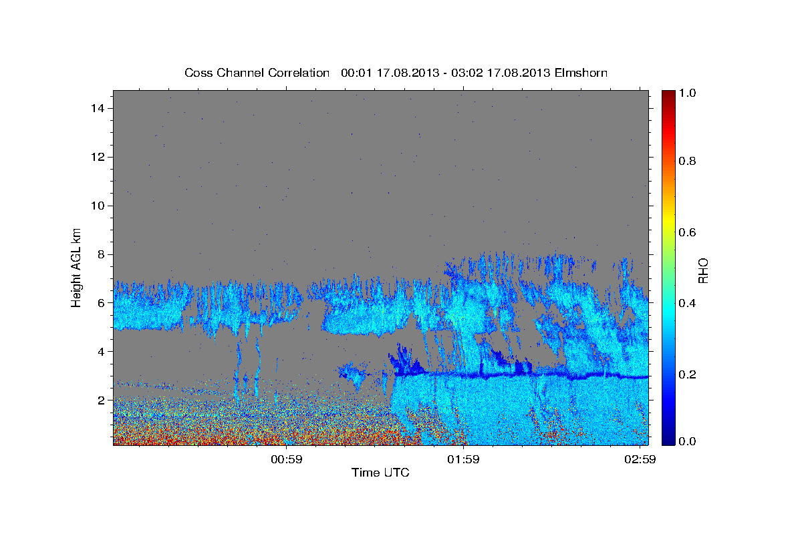

Slide 7
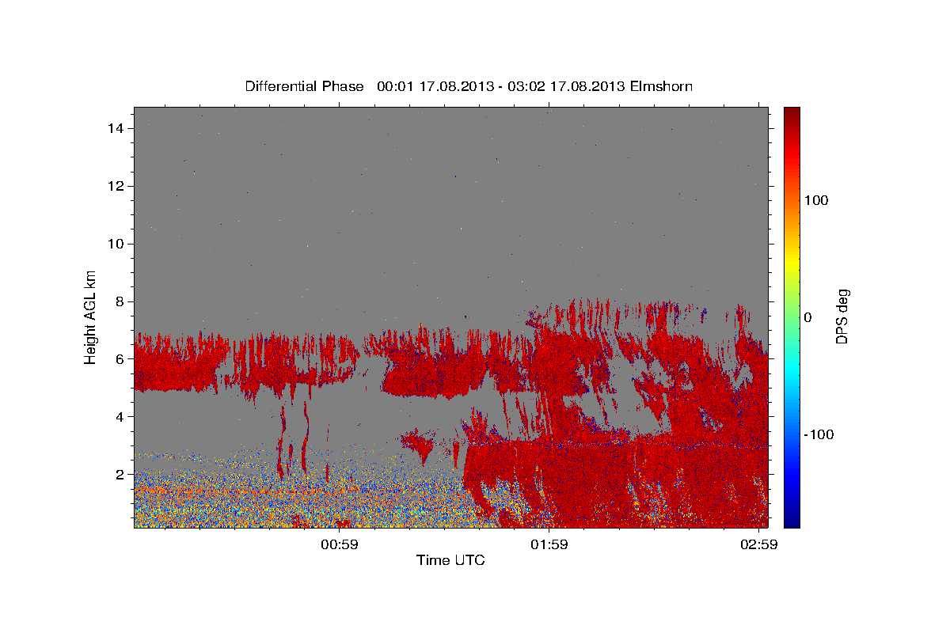

Slide 8
Processing cross spectra
Normally the FFTs+abs^2+averaging is done by the DSP. But inserting the calculation of correlation spectra in the DSP code is much work.
Temporary solution: FFT-processing moved to the PC. This works with a powerful PC if it is not loaded too much by other tasks.
Raw data client: I-Q data is transferred via socket connection from the radarserver to the IDL program that makes the processing. Therefore saving and reading the I-Q data to and from harddrive is skipped.
On older Radar-PCs it works with 350 range gates (one cpu, without fftw).
Integation of Rho and DSP instead of LWC and RR in the dmp format?
Exploitation of RHO for the target classification and the melting height detection in mmclx
Pulse-Pair

Slide 9
Spectra Format
Zspc: Only spectral lines are saved, where the signal in co or cross channel are above noise threshold. Same Headers as pds (ppar, srvinfo).
In each range gate:
zpeaks: ixa:ixb:spc[ixa:ixb]: ixa:ixb:spc[ixa:ixb]: .. ixa:ixb:spc[ixa:ixb]
Gzip used additionally
Very efficient, may be used online (tail-f)
Ed’s format: If a range gate contains a single line which is above the noise threshold, then the complete spectrum is saved. Each spectrum gets a number. Spectra numbers are like time an infinite array in NetCDF. Each time bin starts with an zrg-elements vector pointing to a spectra number or a to null if there is only noise in the spectrum.
Max’s format: NetCDF4 with gzip-option. Due to replacing noise by HSD level high compression rates are achieved. Requires much CPU.

Slide 10
Ideas for improved spectra data:
Some more points to the left and to the right of each detected peak. Above, below, before, after? -> Better solution: Thresholding in box-averaged data
Plankton filtering before averaging. -> If a frequency-range-time-bin is recognized as plankton 3D environment should be flagged too.
Minimum in time for ground clutter filtering + using LDR for ground clutter filtering.
Output format: a combination of Ed’s and Max’s format: only ranges with data + HSD flooding + NCDF4 gzip.
How should plankton and clutter be saved?
Radarconst and SnrCorfa should be saved separately so that SNR values are still available for quality control.

Slide 11
Problems using NetCDF4 gzip format
IDL6 does not support it – IDL8 hard to buy for all MIRA3X systems at once
Max’s format for custommers that buy IDL8 and zspc for others?
GDL (gnudatalanguage) spectraprocessing and mmclx works, date-time axis in plots does not work. NetCDF4 supported, gzip option can be contributed?
Python or Fortran?
Common IDL source for all MIRA3X systems by using configuration files.
It is difficult to re-implements and test this with another programming language.
Feasible solution: I can add an easy to read but none compressed and data format for online processing (no NetCDF). This format will be used by spectraprocessing.pro and by Max’s fortran conversion routine.

