Slide 1
Estimation of vertical air motion under extreme operation of MIRA36
Martin Hagen DLR Institut für Physik der Atmosphäre Oberpfaffenhofen
Kersten Schmidt, Matthias Bauer-Pfundstein, Alexander Partus, Lutz Hirsch, Heike Konow, Friedhelm Jansen…

Slide 2
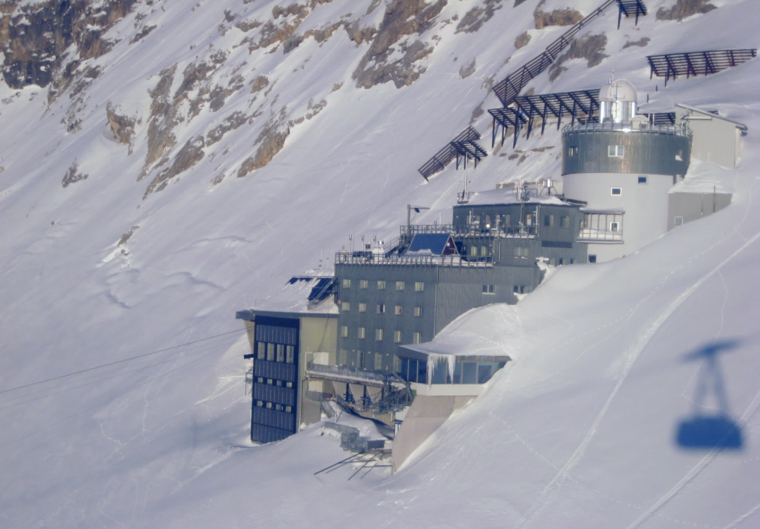
MIRA36 measurements in mountainous region
MIRA36 at UFS Environment Research Station Schneefernerhaus (2650 m MSL)
http://www.pa.op.dlr.de/poldirad/ufsmira.html
Operation since Nov. 2011
Archive: *.mmclx *.dmp *.zspc *.pds (off-line)

Slide 3
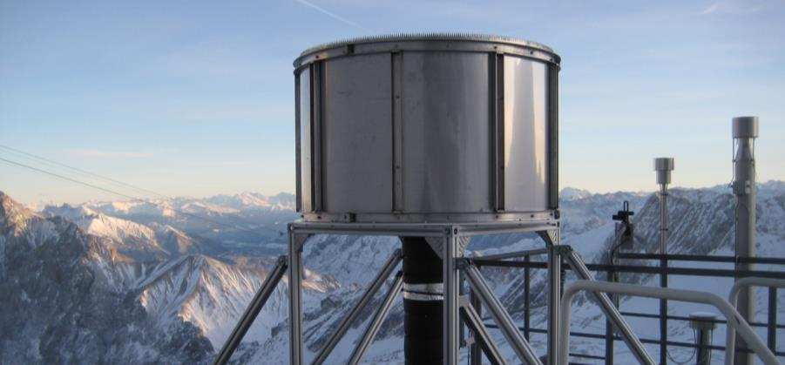
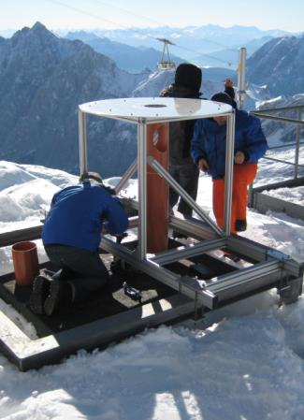
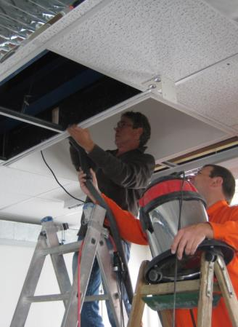
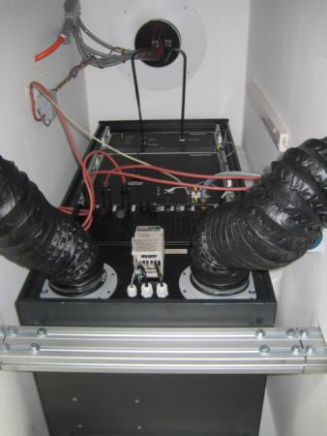
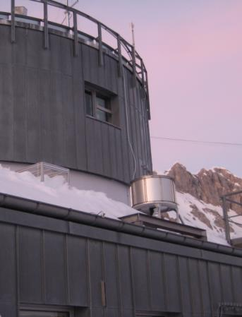
MIRA36 measurements in mountainous region
Challenges:
harsh environment
temperature
snow fall
snow drift
low pressure
adapted installation
limited access

Slide 4
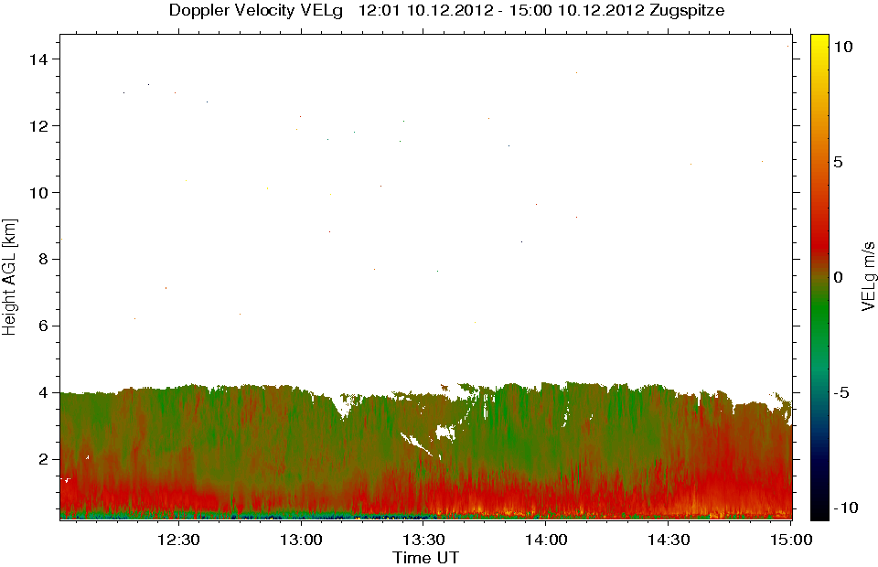
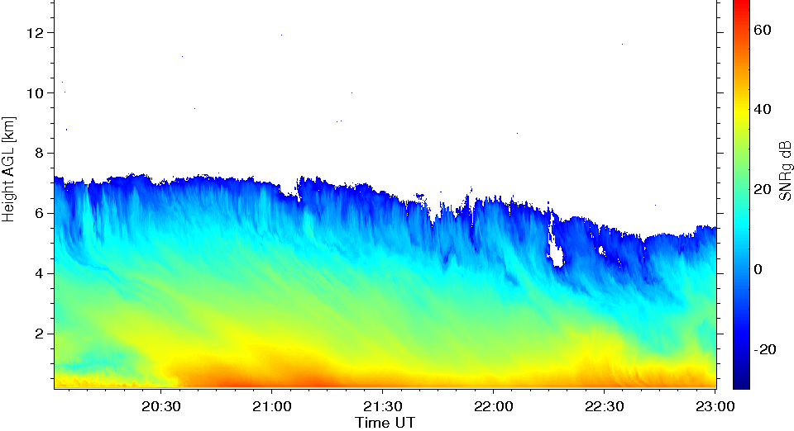
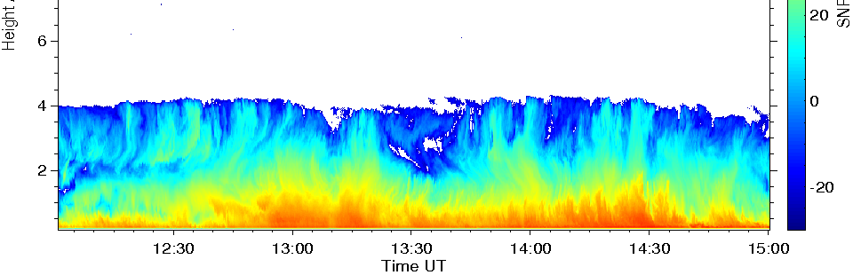
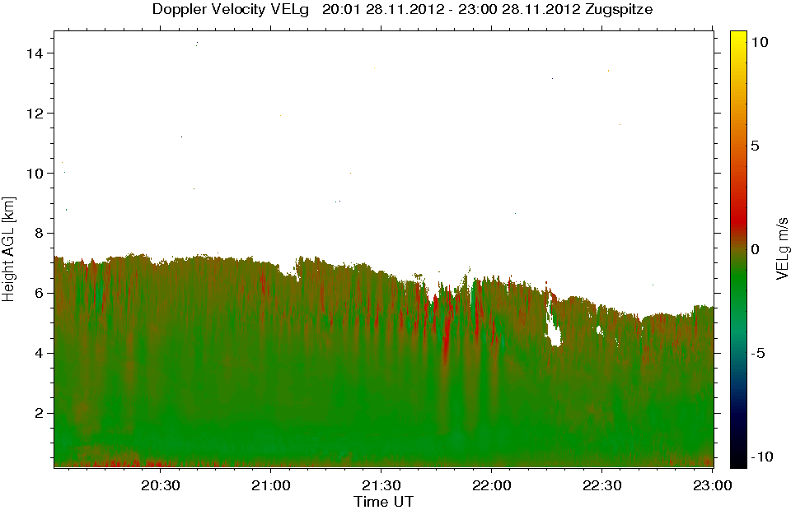
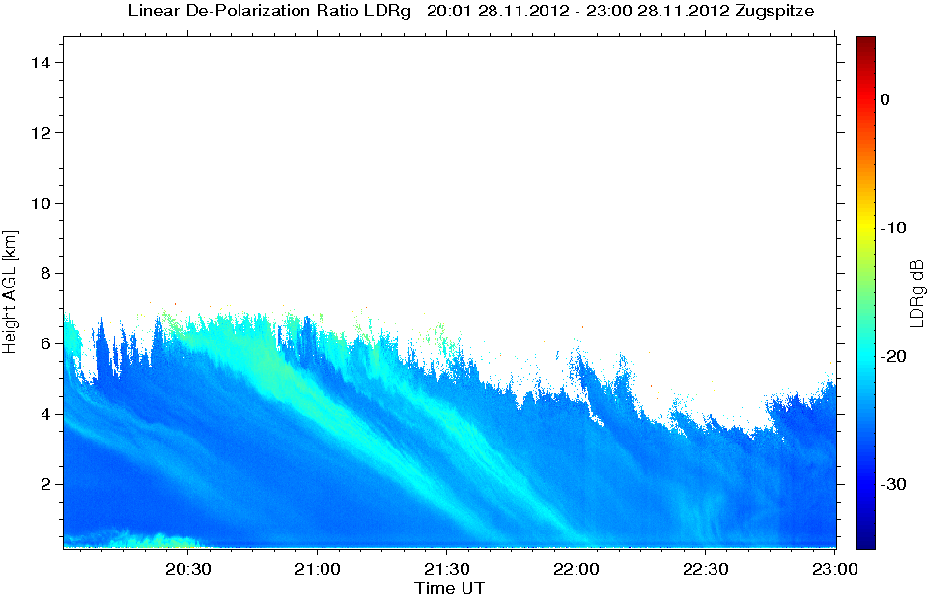
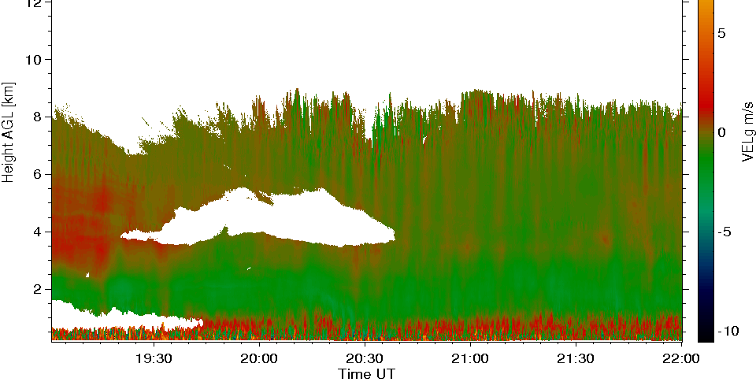
MIRA36 measurements in mountainous region
SNR
10 Dec. 2012
28 Nov. 2012
SNR
VEL
VEL
14 Dec. 2012
VEL
LDR

Slide 5
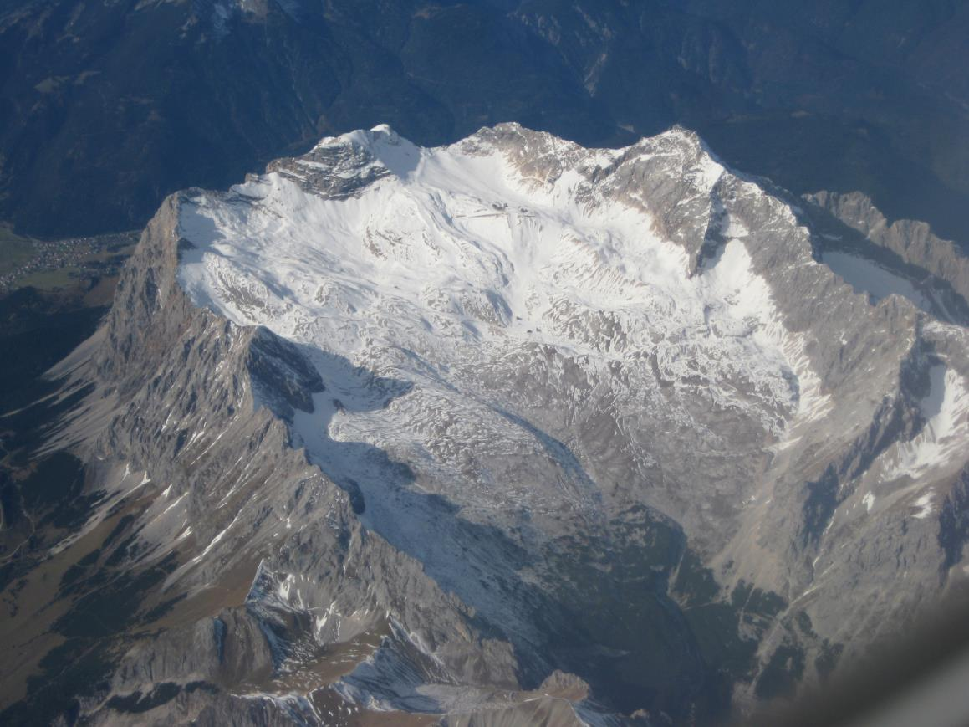
MIRA36 measurements in mountainous region
Zugspitze 2962 m
UFS 2650 m
North
Ehrwald 700 m
Platt 2500 m
Eibsee 1000 m

Slide 6
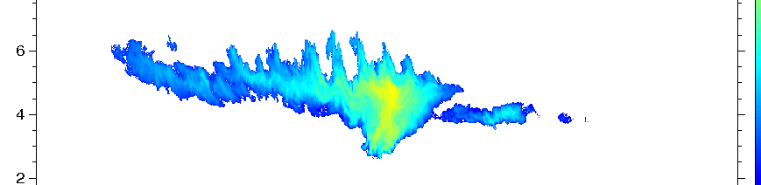
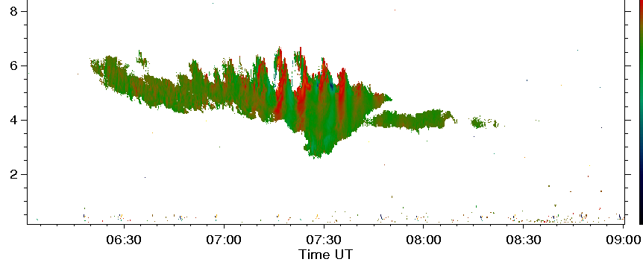
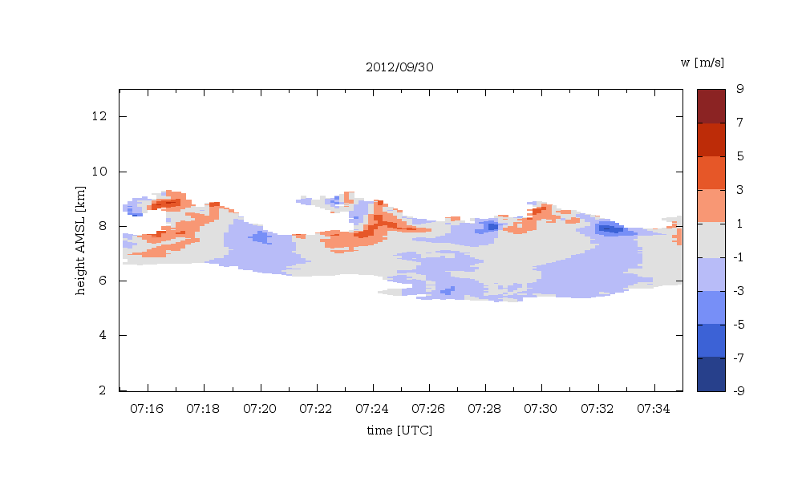
MIRA36 measurements in mountainous region
Example breaking waves 30 Sept. 2012
Reflectivity (dBZ)
Doppler velocity (m/s)

Slide 7
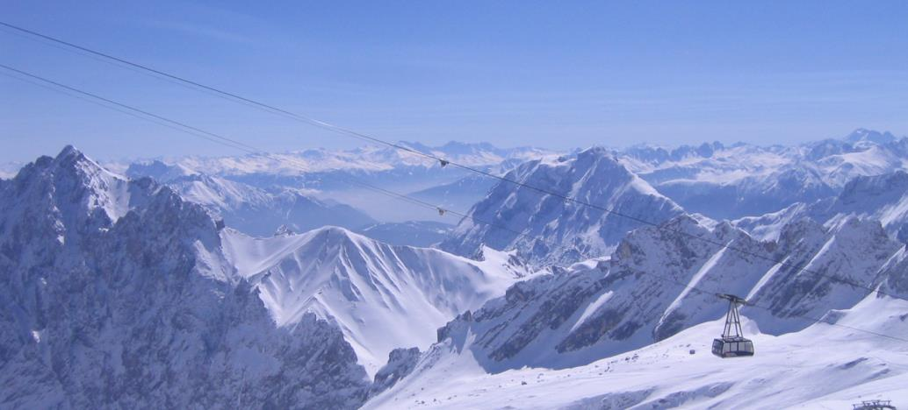
MIRA36 measurements in mountainous region
clutter from Gletscherbahn gondola
SNR
LDR
VEL
24 Feb. 2014

Slide 8
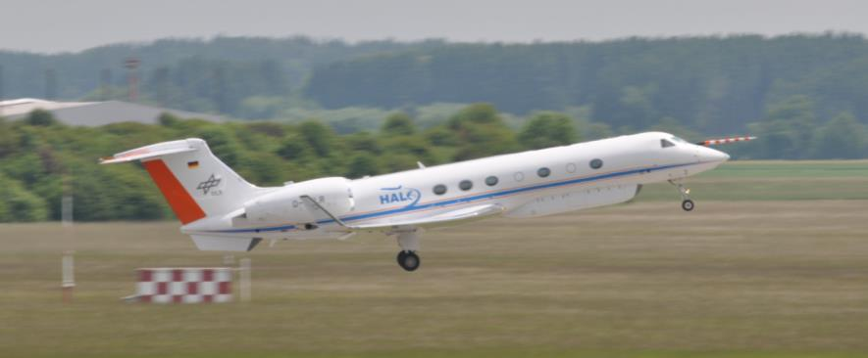
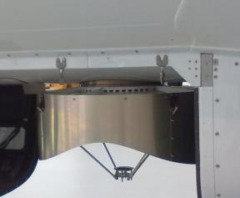
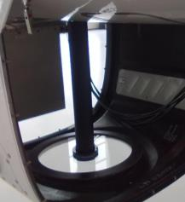
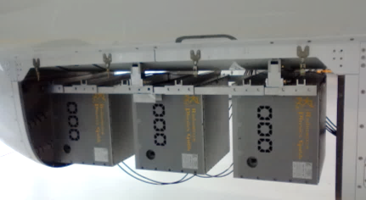
HAMP – HALO Microwave Package
MIRA cloud radar
RPG microwave radiometers
WALES water vapour lidar
Cloudradar 35 GHz
WALES
Microwave radiometer 183 22/58 90/119 GHz

Slide 9
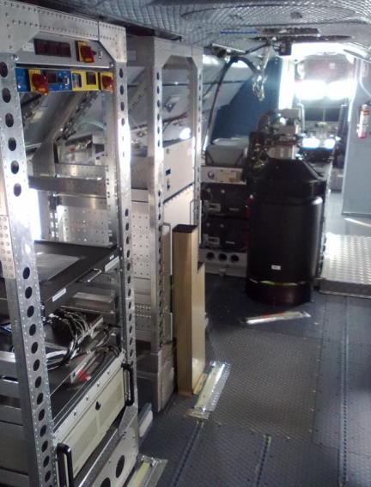
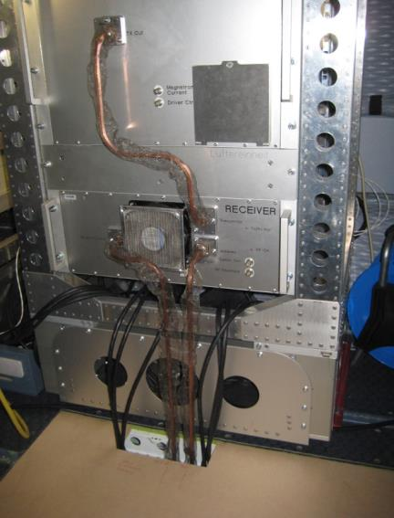
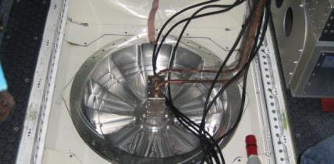
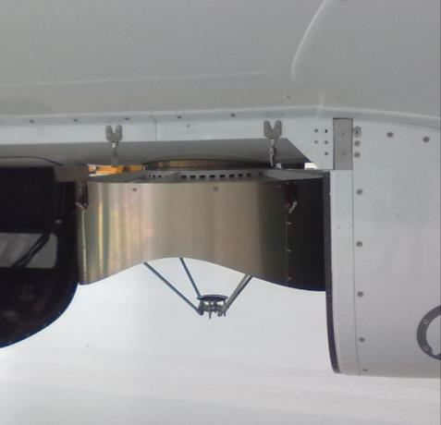
HALO Cloud Radar
Modified MIRA 36 for aircraft use
EMC compatibility
mitigation of electromagnetic radiation in the cabin
adapted clutter fence
any technical modification requires paper work, costs, time, …
dryer
display keyboard KVM switch
TX
WALES
RX
3 PC’s radiometer
antenna with clutter fence mounted in rear bottom window frame
PC radar

Slide 10
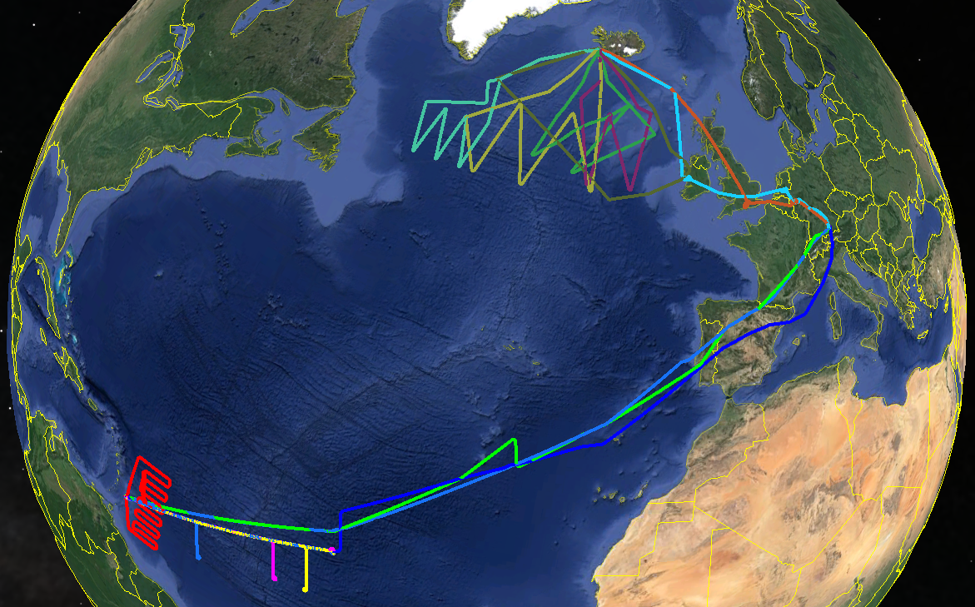
NARVAL Next-generation Aircraft Remote Sensing for Validation Studies
NARVAL North, January 2014 (post-frontal extra-tropics systems) PI: Bjorn Stevens, Felix Ament
NARVAL South, December 2013 (North Atlantic trade wind clouds) PI: Christian Klepp, Stephan Bakan
total about 135 hours flights

Slide 11
HALO Cloud Radar
Challenges:
Calibration (additional losses through radom plate, longer wave guides) ➔ Intercomparison with other MIRA, Cloudsat, RASTA, …
Aircraft speed of 240 m/s requires shorter sampling time 1 second (= 20 FFT of 256 samples at 5000 Hz)
Sensitivity issues: boundary water clouds are 10 – 14 km away from radar; broadening of spectra reduces power in spectral peak
Contribution of aircraft motion on Doppler velocity

Slide 12
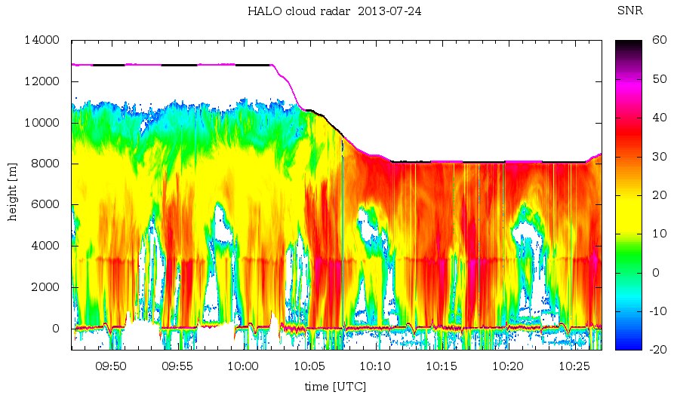
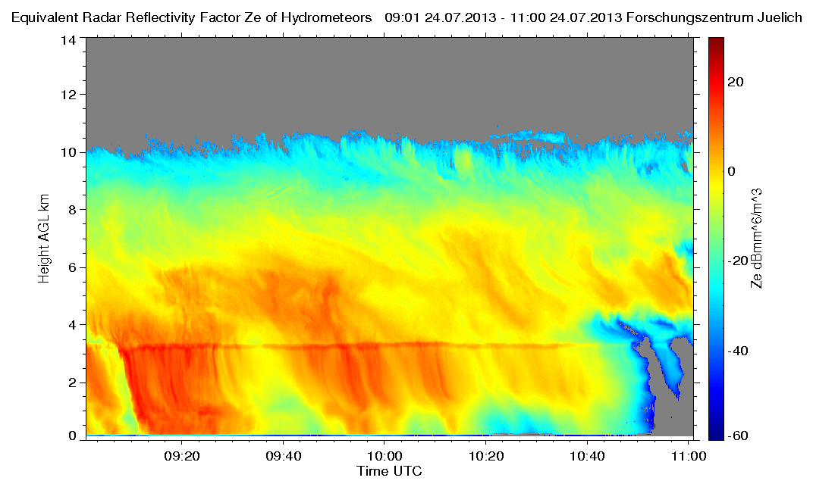
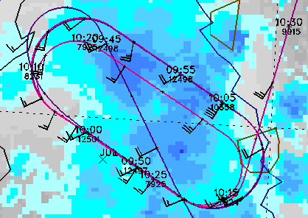
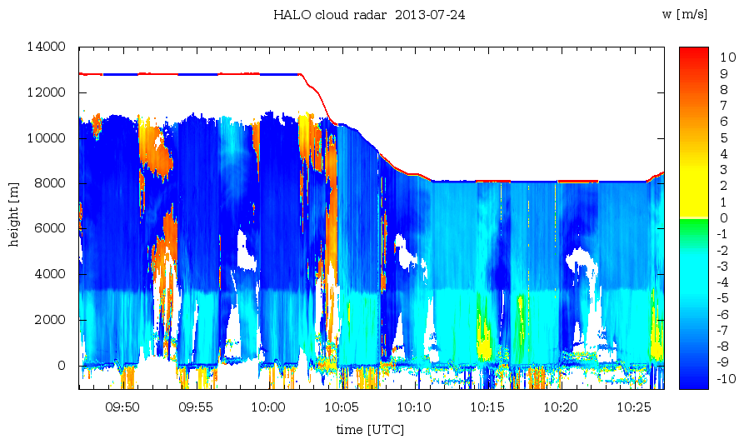
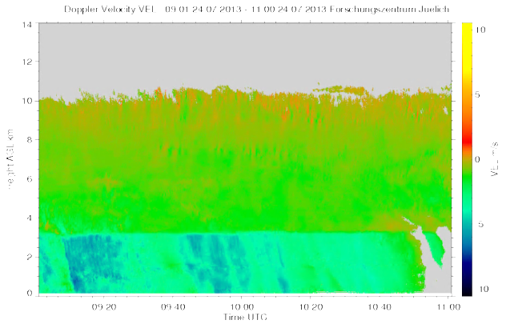
HALO Cloud Radar – Intercomparison with Jülich

Slide 13
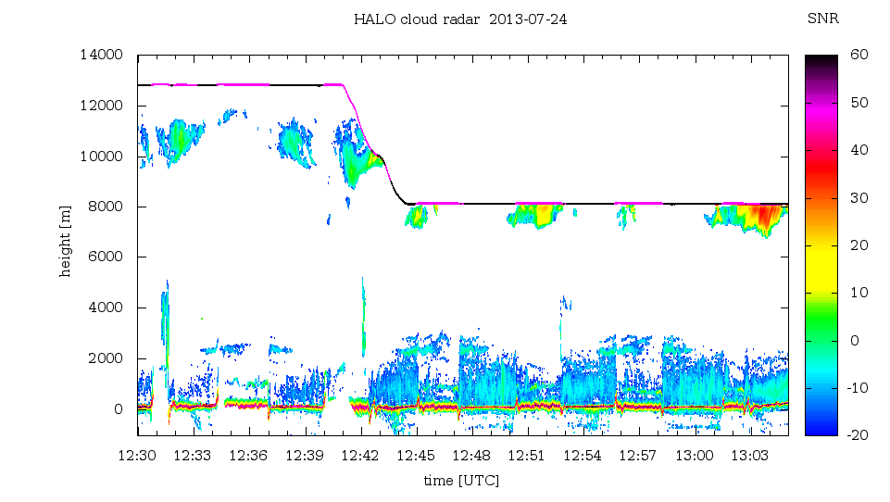
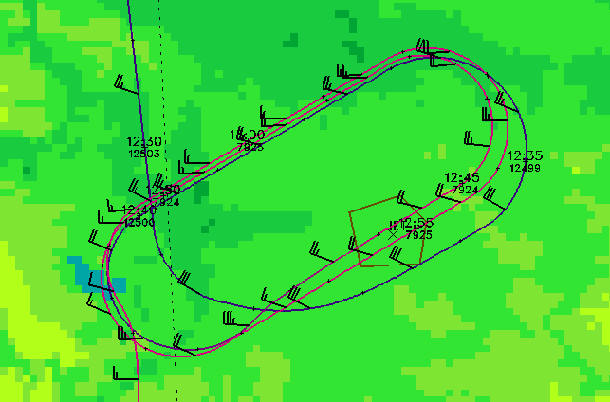
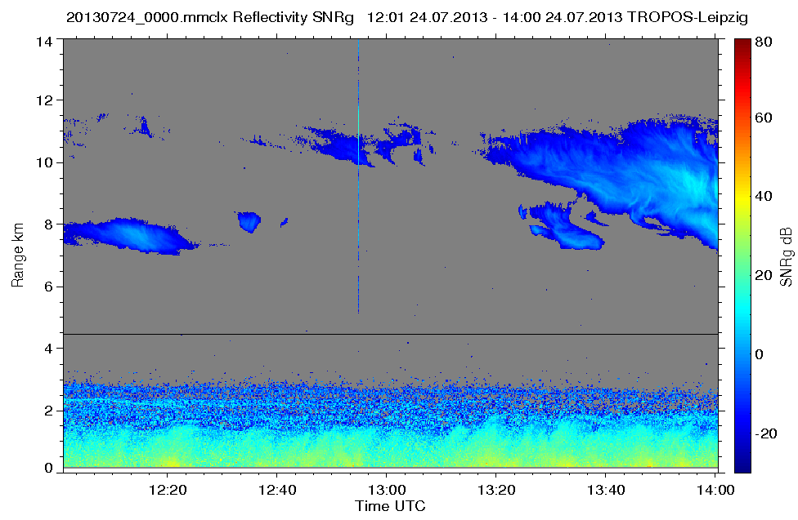
HALO Cloud Radar – Intercomparison with Leipzig
no reflectivities < -30 dBZ
higher boundary layer sensitivity at lower flight height

Slide 14
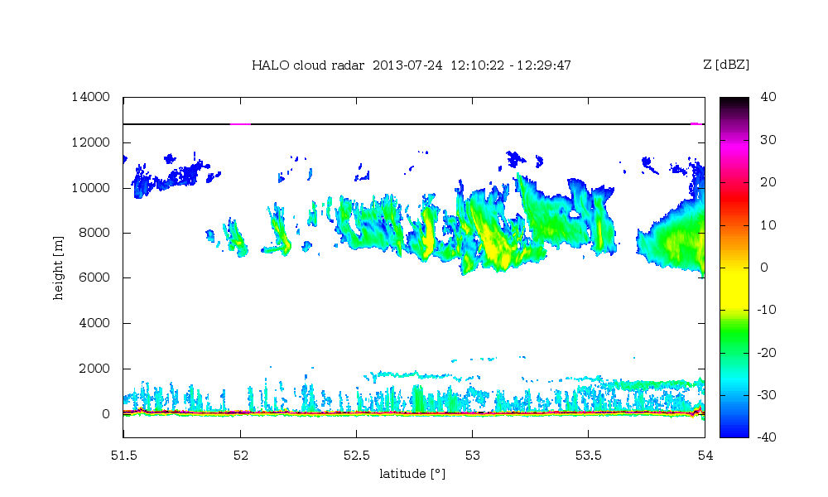
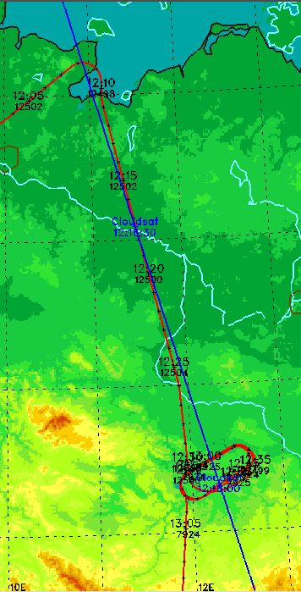
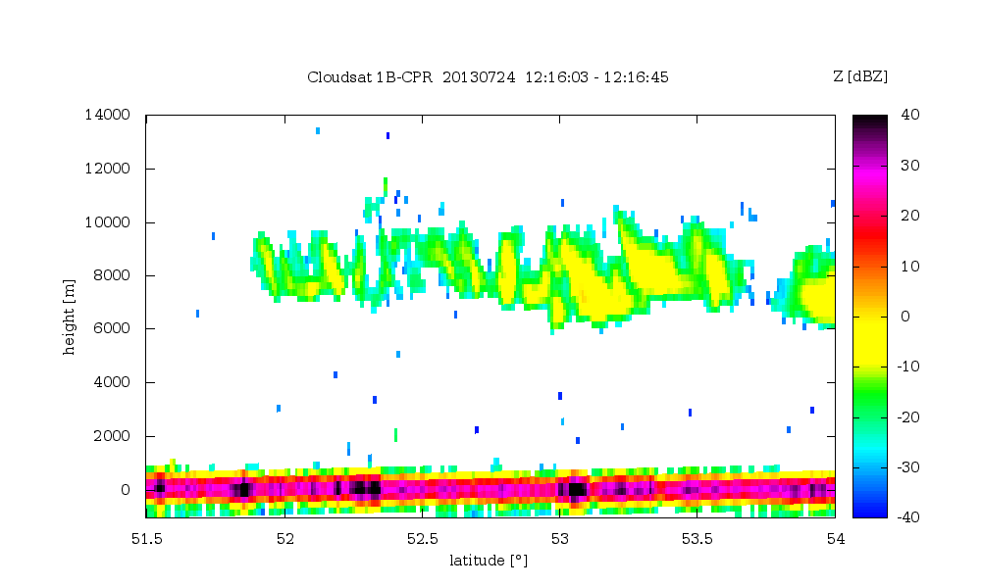
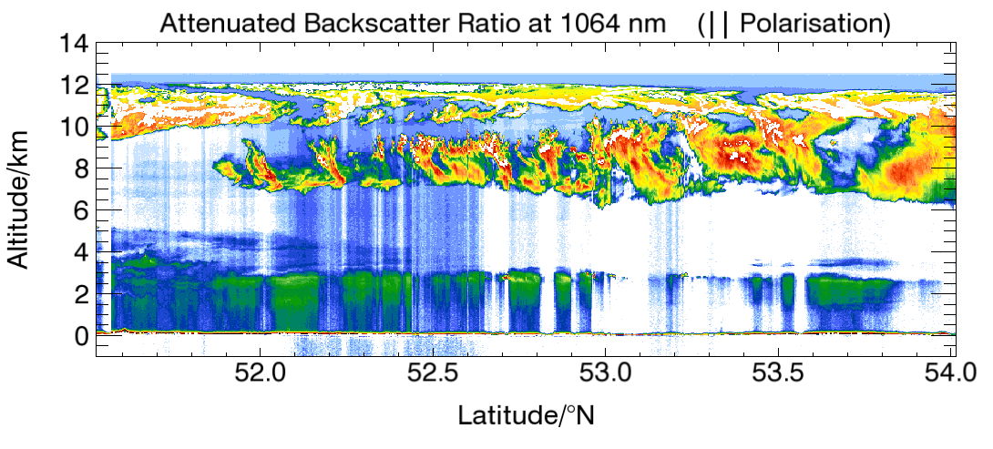
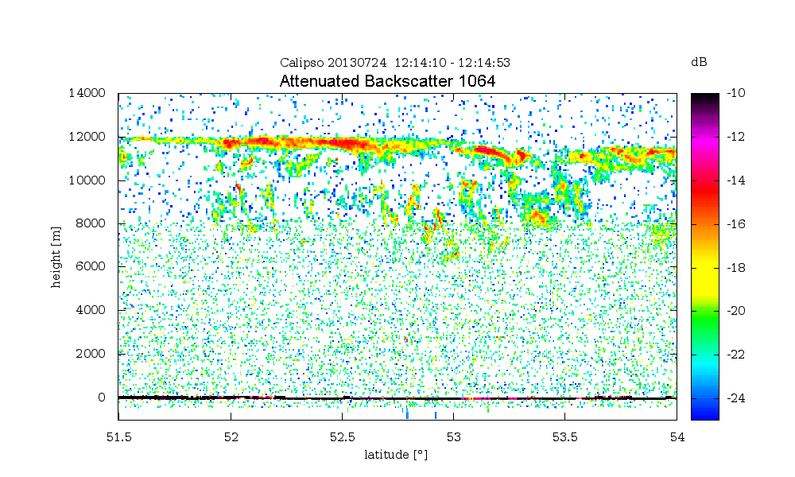
HALO Cloud Radar – Intercomparison with Cloudsat/Calipso
HALO Cloud radar (35 GHz) Reflectivity
14
12
10
8
6
4
2
0
54° N
Altitude (km)
14
12
10
8
6
4
2
0
CLOUDSAT Cloud radar (95 GHz) Reflectivity
53° N
Altitude (km)
HALO WALES Attenuated Backscatter Ratio 1064 nm (|| Pol.)
52° N
CALIPSO Attenuated Backscatter 1064 nm (dB km-1 sr-1)
14
12
10
8
6
4
2
0
51° N
Altitude (km)
51.5 52.0 52.5 53.0 53.5 54.0 Latitude N

Slide 15
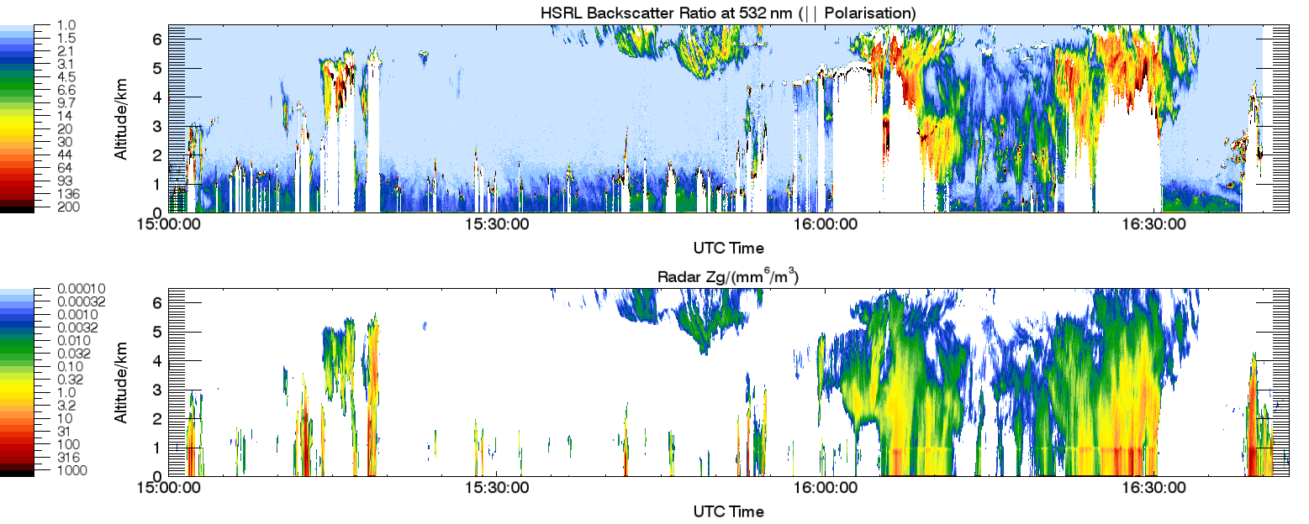
HALO Cloud Radar and Lidar
Radar reflectivity Z α D⁶; Lidar backscatter β α D²
Lidar sensitive on hydrometeor concentration; signal can be saturated
Radar sensitive on hydrometeor size; cumulus clouds, water clouds and thin cirrus can be missed
NARVAL North 21-02-2014

Slide 16
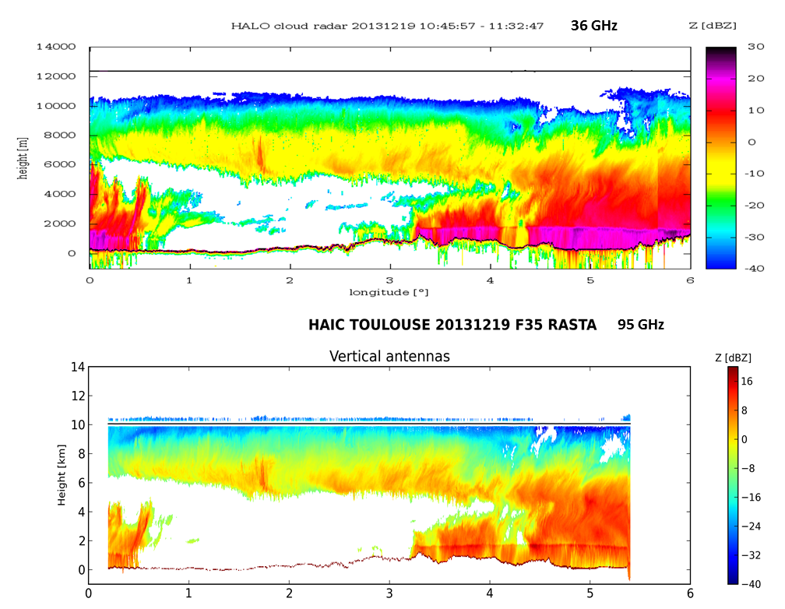
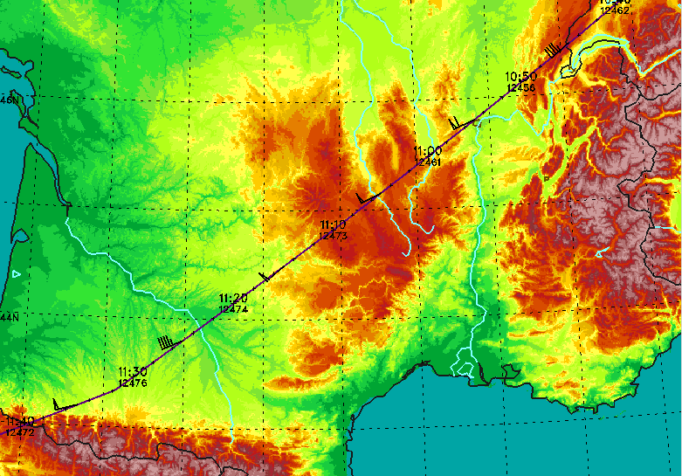
HALO Cloud Radar – Intercomparison with French RASTA
Joint flight
during NARVAL
between
Lyon and
Tarbes

Slide 17
HALO – Cloud Radar
Contribution of aircraft motion on Doppler velocity
Aircraft vertical motion up – down → neglectible (?!?)
Pitch of aircraft (1.5 – 3°) ➔ 2° @ 210 m/s = 7.2 m/s depends on weight and speed
Broadening of Doppler spectrum ➔ 0.6 m/s spectral width by finite beam width introduced
Influence of wind profile if → wind profil is not known pitch is non-zero normally, dropsondes can give estimate

Slide 18
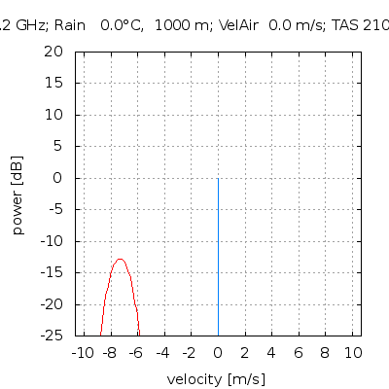
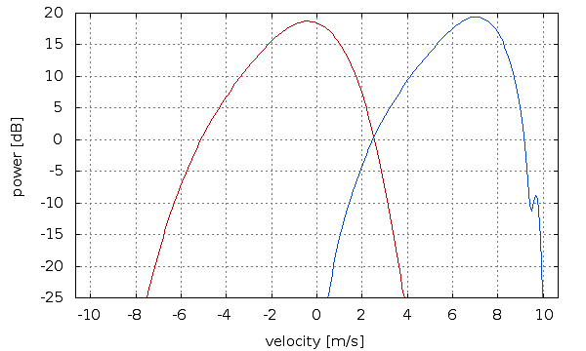
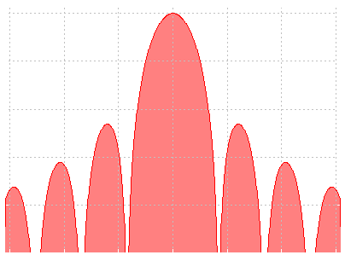
HALO – Cloud Radar
Contribution of aircraft motion on Doppler velocity
Simulations with 2° pitch, TAS 210 m/s
rain fall 5 mm/h Marshall- single bin 0 dBZ Palmer size distribution
-13 dB

Slide 19
Summary
Calibration issue
Schneefernerhaus: longer waveguide than usual hard to place an other MIRA for comparison
HALO cloud radar: loss through radom plate 1.5 dB one-way (different estimations, measurements at on point in radom only) intercomparison with other MIRA36, but also other radars
Dopper velocity Doppler velocity = vertical air motion + fall speed of hydrometeors
Schneefernerhaus: large influence of flow over Alps
HALO aircraft motion does contaminate Doppler velocities

