Slide 1
Outline
Component based calibration (Budged calibration). Experience about maintenance requirement.
Some Ideas for independent calibration validation

Slide 2
Ideas for independent calibration:
Corner reflector large distance is required to prevent saturation by ground clutter Ground reflections – Quadrocopter -- balloon rotating corner reflectors (mill)
Sun radiation for monitoring the receiver performance including antenna
taveling radar for equalizing the calibration of all sites.

Slide 3
Maintenance of the component based calibration:
Parameters needed by the component based Calibration:
Average transmitting power: measurement by internal thermistor is very stable
The receiver gain is deduced by relating the measured signal - to the receiver noise - or to the signal of an internal reference noise source The power of both “internal noise sources” is measured by comparing to a calibrated external noise source. This measurement should be repeated from time to time. RelNF shows the agreement of the two internal noise sources (DSP-bug).
Pulse width (see next slide)
Magnetron frequency
Antenna gain and waveguides measured only during production. Leaves cause significant degradation of ICPR Wet antenna loss 2-5 dB (radiometric noise, compressor)

Slide 4
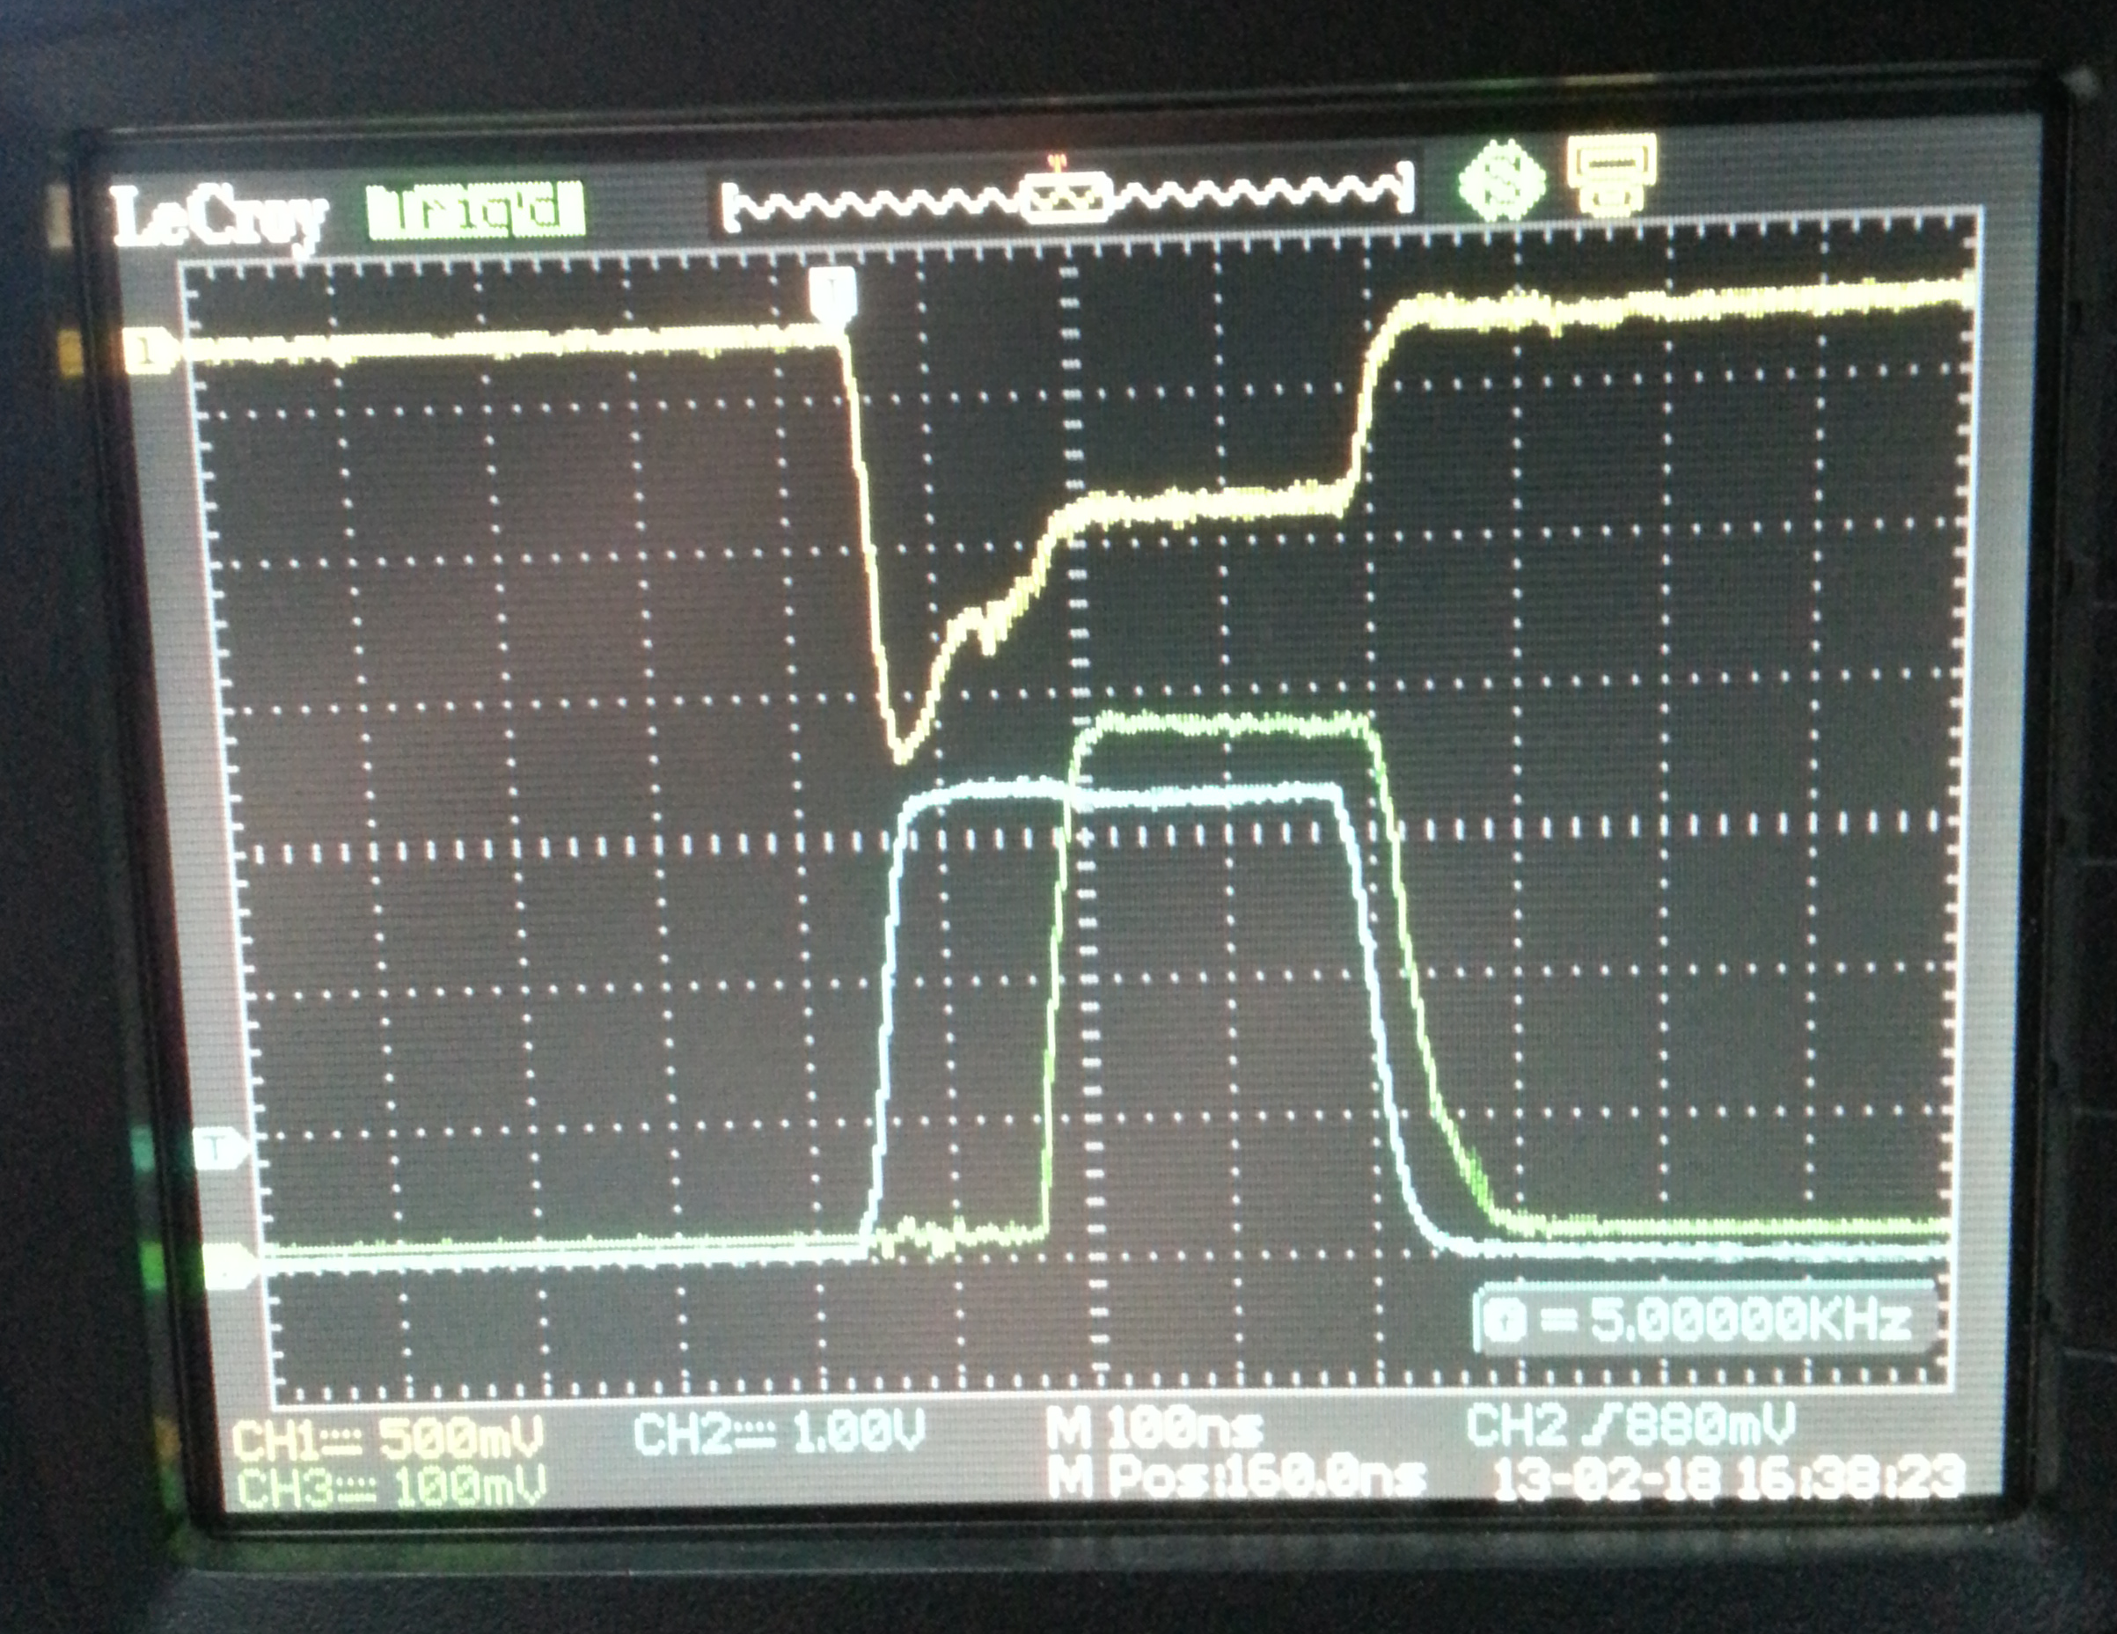
Delay by residual capacities. Maximum current is getting smaller by ageing.
Pulse width can be measured by scope and by DSP testmode. Its knowledge is important pulse power adjustment.
It can be adjusted by Modulator Grid Voltage, and driver pulse length (“add to pulse”)
Solid state modulator developed and tested. Yet it works only for the magnetrons that require less than 14000 V.

